Slide 1
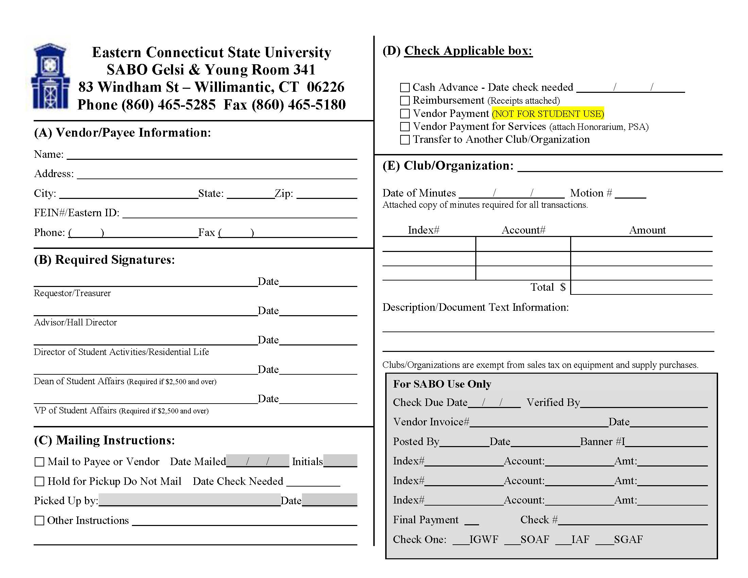
This tutorial will display step by step instructions on how to fill out a voucher form for a reimbursement payment.

Slide 2
1. This form is only used after a club member has purchased supplies with their personal funds instead of the club’s budget. This should be a last resort option. We will not reimburse 1 student for large amounts of money.

Slide 3
Full Name
Mailing Address
City
State
Zip Code
Eastern ID #
### ### ####
2. Begin by filling out each line in Section A for the club member being reimbursed.

Slide 4
Full Name
Mailing Address
City
State
Zip Code
Eastern ID #
### ### ####
Student Signature
MM/DD/YY
3. In Section B, the club member being reimbursed (or whoever has been designated to sign paperwork) will sign on the requestor/treasurer line.

Slide 5
Full Name
Mailing Address
City
State
Zip Code
Eastern ID #
### ### ####
Student Signature
MM/DD/YY
Advisor Signature
MM/DD/YY
4. The club advisor MUST sign this form on the Advisor/Hall Director line.
The reimbursement cannot be completed without the advisor’s signature.

Slide 6
Full Name
Mailing Address
City
State
Zip Code
Eastern ID #
### ### ####
Student Signature
MM/DD/YY
Advisor Signature
MM/DD/YY
Check One:
5. Section C is where the club member chooses how to receive the payment in the form of a check.
“Mail to Payee or Vendor” = Check gets mailed to their address listen on form.
“Hold for Pickup” = Checks are to be picked up in Accounts Payable Office (3rd floor Gelsi Young)

Slide 7
Check Reimbursement Box:
x
Full Name
Mailing Address
City
State
Zip Code
Eastern ID #
### ### ####
Student Signature
MM/DD/YY
Advisor Signature
MM/DD/YY
Check One:
6. In Section D, check the box for Reimbursement. Make sure any/all receipts are attached for what is being reimbursed.

Slide 8
Check Reimbursement Box:
x
Full Name
Student Organization
Mailing Address
City
State
Zip Code
Eastern ID #
### ### ####
Student Signature
MM/DD/YY
Advisor Signature
MM/DD/YY
Check One:
7. In Section E, fill out the name of the Organization that is requesting the reimbursement.

Slide 9
Check Reimbursement Box:
x
Full Name
Student Organization
Mailing Address
City
State
Zip Code
MM DD YY
1
Eastern ID #
### ### ####
Student Signature
MM/DD/YY
Advisor Signature
MM/DD/YY
Check One:
8. The club minutes must show the appropriate motion requesting to reimburse said club member.
Fill in the corresponding Date of Minutes and Motion # reflected in attached minutes.

Slide 10
Check Reimbursement Box:
x
Full Name
Student Organization
Mailing Address
City
State
Zip Code
MM DD YY
1
Eastern ID #
### ### ####
XBAM##
Student Signature
MM/DD/YY
Advisor Signature
MM/DD/YY
Check One:
9. The club’s index # is one of two options. Each club has a fundraising and budget account.
XBAM## = Budget
XFUN## = Fundraising

Slide 11
Check Reimbursement Box:
x
Full Name
Student Organization
Mailing Address
City
State
Zip Code
MM DD YY
1
Eastern ID #
### ### ####
XBAM##
$00.00
Student Signature
MM/DD/YY
$00.00
Advisor Signature
MM/DD/YY
Check One:
10. Fill in the amount being reimbursed in the ‘amount’ box and ‘total’ box. This amount must match the amount on the attached receipt and minutes.
**NOTE: CANNOT BE REIMBURSED FOR TAX.

Slide 12
Check Reimbursement Box:
x
Full Name
Student Organization
Mailing Address
City
State
Zip Code
MM DD YY
1
Eastern ID #
### ### ####
XBAM##
$00.00
Student Signature
MM/DD/YY
$00.00
Advisor Signature
MM/DD/YY
What is the reimbursement for? What event was it from? Where were supplies purchased?
Check One:
11. Lastly, the description must be filled out specifically to the reimbursement. State what the supplies were, where they were purchased, which event they were purchased for.

Slide 13
Check Reimbursement Box:
x
Full Name
Student Organization
Mailing Address
City
State
Zip Code
MM DD YY
1
Eastern ID #
### ### ####
XBAM##
$00.00
Student Signature
MM/DD/YY
$00.00
Advisor Signature
MM/DD/YY
What is the reimbursement for? What event was it from? Where were supplies purchased?
Check One:
12. All reimbursement forms MUST have the receipts attached AND minutes reflecting the motion to reimburse said club member. The minutes must explicitly state which club member is being reimbursed.

