Slide 1
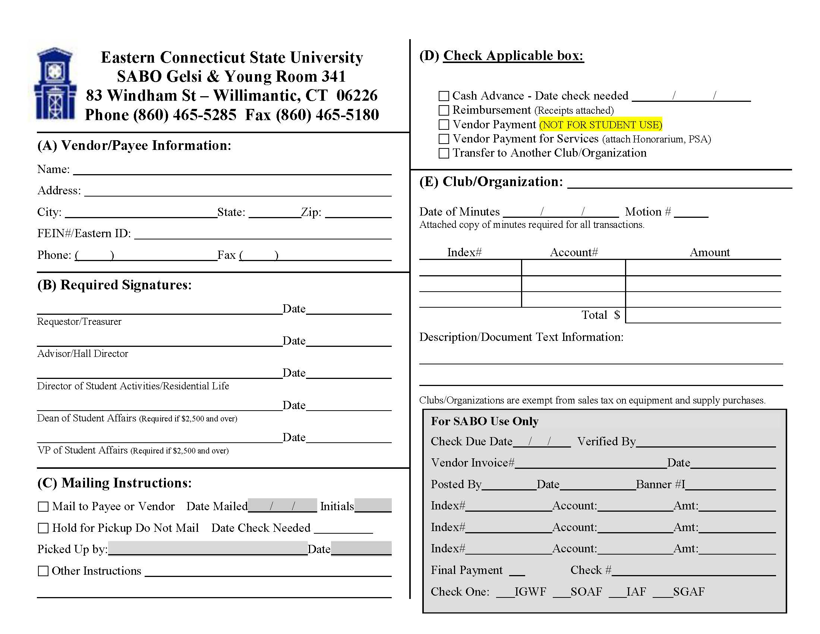
This tutorial will display step by step instructions on how to fill out a voucher form for contracts.

Slide 2
Full Name
Mailing Address
City
State
Zip Code
FEIN# (from W9)
### ### ####
### ### ####
1. Begin by only filling out section A to match the information provided on the contract.

Slide 3
Full Name
Mailing Address
City
State
Zip Code
Eastern ID #
### ### ####
Student Signature
MM/DD/YY
2. In Section B, the club member being filling out the voucher (or whoever has been designated to sign paperwork) will sign on the requestor/treasurer line.

Slide 4
Full Name
Mailing Address
City
State
Zip Code
Eastern ID #
### ### ####
Student Signature
MM/DD/YY
Advisor Signature
MM/DD/YY
3. The club advisor MUST sign this form on the Advisor/Hall Director line.
The reimbursement cannot be completed without the advisor’s signature.

Slide 5
Full Name
Mailing Address
City
State
Zip Code
Eastern ID #
### ### ####
Student Signature
MM/DD/YY
Advisor Signature
MM/DD/YY
Check One:
5. Section C is where your club chooses how to give the payment in the form of a check.
“Mail to Payee or Vendor” = Check gets mailed to the address listen on the voucher.
“Hold for Pickup” = Checks are to be picked up in Accounts Payable Office (3rd floor Gelsi Young).

Slide 6
Check Vendor Payment for Services Box:
x
Full Name
Mailing Address
City
State
Zip Code
Eastern ID #
### ### ####
Student Signature
MM/DD/YY
Advisor Signature
MM/DD/YY
Check One:
5. In Section D, check the box for Vendor Payment for Services. Make sure any/all supporting documents (including the contract) are attached for what is being reimbursed.

Slide 7
Check Vendor Payment for Services Box:
x
Full Name
Student Organization
Mailing Address
City
State
Zip Code
Eastern ID #
### ### ####
Student Signature
MM/DD/YY
Advisor Signature
MM/DD/YY
Check One:
6. In Section E, fill out the name of the Organization that is requesting the reimbursement.

Slide 8
Check Reimbursement Box:
x
Full Name
Student Organization
Mailing Address
City
State
Zip Code
MM DD YY
1
Eastern ID #
### ### ####
Student Signature
MM/DD/YY
Advisor Signature
MM/DD/YY
Check One:
7. The club minutes must show the appropriate motion requesting to reimburse said club member.
Fill in the corresponding Date of Minutes and Motion # reflected in attached minutes.

Slide 9
Check Reimbursement Box:
x
Full Name
Student Organization
Mailing Address
City
State
Zip Code
MM DD YY
1
Eastern ID #
### ### ####
XBAM##
Student Signature
MM/DD/YY
Advisor Signature
MM/DD/YY
Check One:
8. The club’s index # is one of two options. Each club has a fundraising and budget account.
XBAM## = Budget
XFUN## = Fundraising

Slide 10
Check Reimbursement Box:
x
Full Name
Student Organization
Mailing Address
City
State
Zip Code
MM DD YY
1
Eastern ID #
### ### ####
XBAM##
$00.00
Student Signature
MM/DD/YY
$00.00
Advisor Signature
MM/DD/YY
Check One:
9. Fill in the amount being paid in the ‘amount’ box and ‘total’ box. This amount must match the amount on the attached contract and minutes.

Slide 11
Check Reimbursement Box:
x
Full Name
Student Organization
Mailing Address
City
State
Zip Code
MM DD YY
1
Eastern ID #
### ### ####
XBAM##
$00.00
Student Signature
MM/DD/YY
$00.00
Advisor Signature
MM/DD/YY
What is the payment for? What event was it from? Be Specific.
Check One:
10. Lastly, the description must be filled out specifically to the contract. State what the payment was for, what event, and any additional details.

Slide 12
Check Reimbursement Box:
x
Full Name
Student Organization
Mailing Address
City
State
Zip Code
MM DD YY
1
Eastern ID #
### ### ####
XBAM##
$00.00
Student Signature
MM/DD/YY
$00.00
Advisor Signature
MM/DD/YY
What is the reimbursement for? What event was it from? Where were supplies purchased?
Check One:
12. All contract vouchers MUST have the contract attached, minutes reflecting the motion, W9, and nondiscrimination form.

