Slide 1
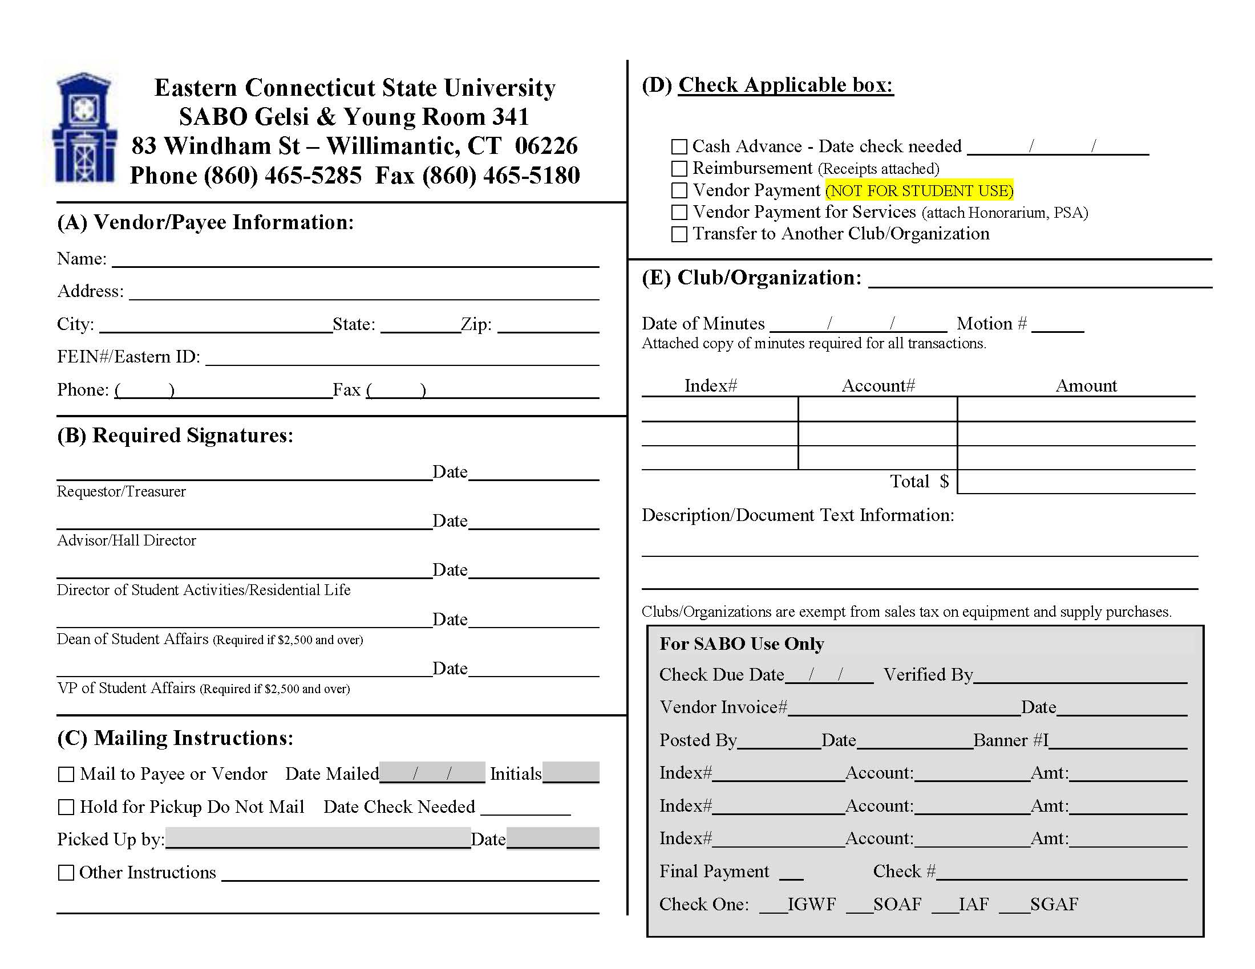
1. This tutorial will display step by step instructions on how to fill out a voucher form for Chartwell invoices.

Slide 2
Chartwells
2. Begin by only filling out the name line in section A. In this space, write in “Chartwells”
Leave the rest of section A blank.

Slide 3
Chartwells
Student Signature
MM/DD/YY
3. In Section B, the club member requesting the P-Card (or whoever has been designated to sign paperwork) will sign on the requestor/treasurer line.

Slide 4
Chartwells
Student Signature
MM/DD/YY
Advisor Signature
MM/DD/YY
4. The club advisor MUST sign this form on the Advisor/Hall Director line.
The P-Card cannot be taken out without the advisor’s signature.

Slide 5
Chartwells
Student Signature
MM/DD/YY
Advisor Signature
MM/DD/YY
5. Section C does not need to be filled out for this form.

Slide 6
Check the Vendor Payment box
X
Chartwells
Student Signature
MM/DD/YY
Advisor Signature
MM/DD/YY
6. Check the “Vendor Payment” box in Section D.

Slide 7
Check the Vendor Payment box
X
Chartwells
Student Organization
Student Signature
MM/DD/YY
Advisor Signature
MM/DD/YY
7. In Section E, fill out the name of the Organization that is requesting the P-Card.

Slide 8
Check the Vendor Payment box
X
Chartwells
Student Organization
MM DD YY
1
Student Signature
MM/DD/YY
Advisor Signature
MM/DD/YY
8. The club minutes must show the appropriate motion requesting use of the P-Card.
Fill in the corresponding Date of Minutes and Motion # reflected in attached minutes.

Slide 9
Check the Vendor Payment box
X
Chartwells
Student Organization
MM DD YY
1
XBAM##
Student Signature
MM/DD/YY
Advisor Signature
MM/DD/YY
9. The club’s index # is one of two options. Each club has a fundraising and budget account.
XBAM## = Budget
XFUN## = Fundraising

Slide 10
Check the Vendor Payment box
X
Chartwells
Student Organization
MM DD YY
1
XBAM##
Student Signature
MM/DD/YY
Advisor Signature
MM/DD/YY
10. The “amount” lines will be filled out upon the club’s return from shopping. If more than one store was visited, each line will represent one store’s purchase.

Slide 11
Check the Vendor Payment box
X
Chartwells
Student Organization
MM DD YY
1
XBAM##
Student Signature
MM/DD/YY
Advisor Signature
MM/DD/YY
11. The “total” box MUST equal the sum of the “amount” lines and CANNOT be more than the amount requested in the club’s motion.

Slide 12
Check the Vendor Payment box
X
Chartwells
Student Organization
MM DD YY
1
XBAM##
Student Signature
MM/DD/YY
Advisor Signature
MM/DD/YY
Food type. Event name. Invoice #.
12. Lastly, the description must be filled out specifically to the club’s Chartwells order.
List the food type, event name, and invoice number given by Chartwells.

Slide 13
Check the Vendor Payment box
X
Chartwells
Student Organization
MM DD YY
1
XBAM##
Student Signature
MM/DD/YY
Advisor Signature
MM/DD/YY
Food type. Event name. Invoice #.
13. Be sure to attach Chartwell’s invoice and minutes to this form in order for this to be complete.

