Slide 1


EASTERN
Teacher Certification Instructions
Spring 2025

Slide 2
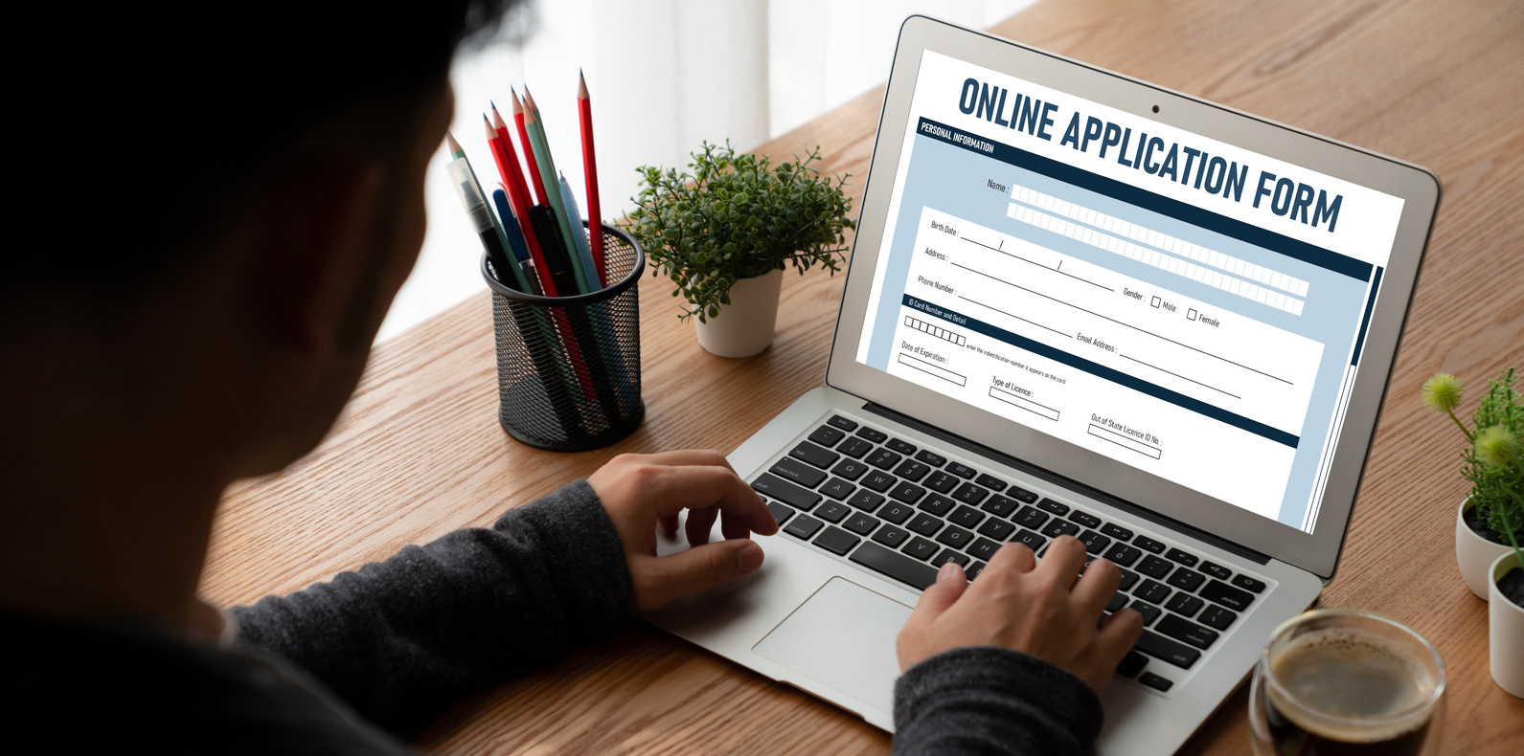

TWO APPLICATIONS:
Eastern’s Application: TK20
WATCH this instructional video for assistance
CT State Department of Education Application
WATCH this instructional video for assistance

Slide 3


FOR EASTERN’S APPLICATION:
EIN NUMBER
CLOCK HOURS
PROOF OF DYSLEXIA
MODULE COMPLETION
  Obtain this by visiting this website. Save your username and password. You will need it again.
  Keep your EIN in a safe place.
  Fill in the digital chart or upload a signed copy
  12 hours total
  MUST complete the “SLD/Dyslexia Webinar Series for Educator Preparation Programs”
PE CANDIDATES ONLY
HPE: FIRST AID CARD
  Make sure it’s not expired

Slide 4

FOR THE STATE APPLICATION:
(BUREAU OF EDUCATOR STANDARDS AND CERTIFICATION)
DEPOSIT
TRANSCRIPTS
FINAL FEE
$50
WATCH this video for instructions on how to send them from Eastern to the state
$200

Slide 5
01.
EASTERN’S APPLICATION IN TK20
You can start this process now. Be sure to save your progress. DO NOT HIT SUBMIT YET.
02.
REGISTER FOR YOUR EIN
Again, save your username and password and keep your EIN in a safe place. You will need it again.
03.
APPLY TO THE STATE OF CT
You can submit even though you’re still working on final requirements.
04.
REQUEST YOUR TRANSCRIPT
It cannot be sent until after you graduate and your degree has posted, but you can request it now.
TIMELINE

Slide 6

05.
UPON COMPLETING STUDENT TEACHING
Return to your TK20 application and complete your clock hours.
Double check that you have completed everything and then hit SUBMIT.
FINAL STEPS

Slide 7
THE PROCESS
Once you complete your student teaching, graduate, and have submitted both applications, you can look for two things:
Eastern will fill out your recommendation to the state IF you have met all of the requirements (including all necessary testing, etc.)
Eastern sends your recommendation to the state and will send you an email letting you know we did so. At the state, it goes to a special email “bank” where it will be checked in the order it was received. If we have sent you an email confirmation, the state has it.
01.

Slide 8
THE PROCESS
Once you complete your student teaching, graduate, and have submitted both applications, you can look for two things:
The state will inform you of any other information you may need to turn in to them, such as test scores, transcripts, etc. Please do so.
Again, sometimes you may be told that they have not received your recommendation from Eastern. If you have our email confirmation, they do have it. They have not processed it from the email “bank”.
That being said- if it’s been at least four to six weeks since graduation and everything else has been turned in, feel free to inquire with nowosielskik@easternct.edu for assistance.
02.

Slide 9
FAQ’S
1.
2.
3.
How long does it take to get my certification?
Can I apply for jobs even if the state hasn’t processed my certification?
I want to make sure I’m not missing anything. Can you walk me through this?
Once everything has been submitted, including your Eastern recommendation, it can take 4-8 weeks for your certification to process.
Yes! If everything has been submitted and you’re just waiting... please apply! Let them know that you’re just waiting on the state to process everything.
Absolutely. Make an appointment with Kari Nowosielski (nowosielskik@easternct.edu) and we can meet and do it together.

Slide 10
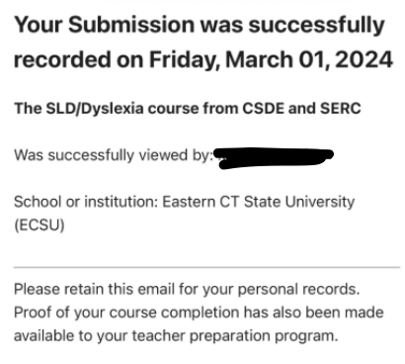
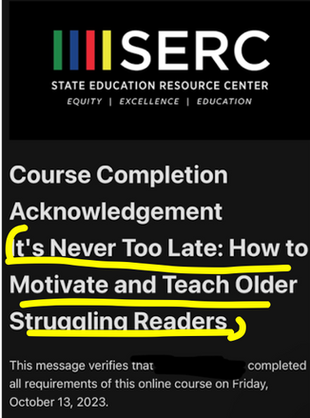
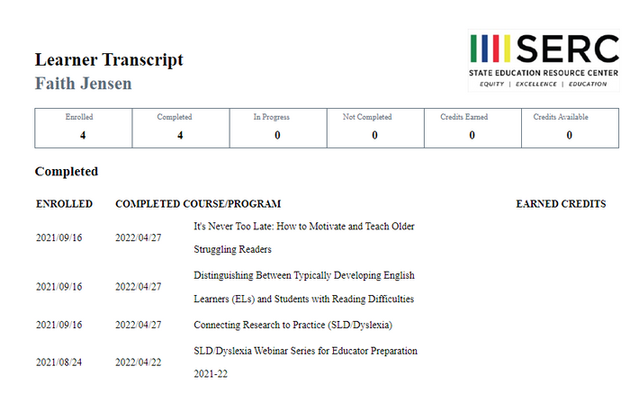

FAQ’S
4.
How do I show I took the dyslexia modules?
You will be asked to upload proof as part of the TK20 application. You need 12
hours in total, including a mandatory module. You may have images like these saved:
mandatory module
additional hours (titles may vary)
OR list that shows all
completed modules
AND

Slide 11
FAQ’S
5.
6.
Do Eastern need my test scores?
I’m not sure what I need to finish certification.
As long as you have given permission for the testing company to share your scores, Eastern is able to see them as soon as they are in. Check in with Kari Nowosielski (nowosielskik@easternct.edu)
with questions.
First, we recommend you meet with your education advisor. You can also email Kari Nowosielski (nowosielskik@easternct.edu) to see what information Eastern has already.

Slide 12


Eastern’s Certification Webpage
CT Department of Education Webpage
REFERENCES

Slide 13


Kari Nowosielski- Certification Auditor
nowosielskik@easternct.edu
Dr. Ryan Colwell- Certification Officer, Assistant Dean
colwellr@easternct.edu
QUESTIONS?

