Slide 1
Center for Early Childhood Education A National Learning Consortium for Research and Professional Development

Slide 2
One Piece of a Larger Picture
Center for Early Childhood Education
Eastern Faculty and
Degree Programs
Child & Family
Development Resource Center

Slide 3
Child and Family Development Resource Center
50 toddlers and preschoolers
78% receive reduced tuition due to moderate or significant financial need
48% Latino
6% African American
26 public pre-Kindergarten slots
Notes:
Enrollment was meant to reflect ethnic and socioeconomic diversity. Not only does this serve the community, but it also ensures that our teaching and our research work is grounded in the real world

Slide 4
Opportunities for Students at the Child & Family Center
Each year:
16 – 30 students have field experiences connected to coursework
2 – 6 students have semester-long practicum placements

Slide 5
Opportunities for Students at the Child & Family Center
Each year:
16 – 30 students have field experiences connected to coursework
2 – 6 students have semester-long practicum placements
3 – 9 physical education students lead PE classes (under faculty direction)

Slide 6
Opportunities for Students at the Child & Family Center
Each year:
16 – 30 students have field experiences connected to coursework
2 – 6 students have semester-long practicum placements
3 – 9 physical education students lead PE classes (under faculty direction)
12 – 15 students are hired as teaching aides

Slide 7
Center for Early Childhood Education Areas of Work
Conduct research
Disseminate research findings
Provide traditional and video-based professional development
Support teacher educators and others who prepare current and future teachers and providers
$5.4M in grants/contracts received over past 10 years to support this work.

Slide 8
Area #1: Research 24 studies in 10 years
"Good-Fit" teacher-child play interactions and the subsequent autonomous play of preschool children
Relationship between teacher education/experience and “good-fit” responses to children's play
The effects of physical and outdoor play on young children's development
Teacher scaffolding and children’s use of technology
Math talk and early mathematical thinking
Effects of teacher training on early literacy skills in preschoolers
Effects of different toys on children’s play

Slide 9
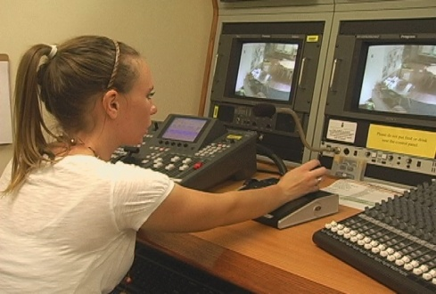
Research
Studies funded by U.S. Department of Education, Spencer Foundation, Head Start Body Start

Slide 10
Research
Studies funded by U.S. Department of Education, Spencer Foundation, Head Start Body Start
41 students served as research assistants

Slide 11
Research
Studies funded by U.S. Department of Education, Spencer Foundation, Head Start Body Start
41 students served as research assistants
30 (additional) students trained and hired to conduct child assessments

Slide 12
Research
Studies funded by U.S. Department of Education, Spencer Foundation, Head Start Body Start
41 students served as research assistants
30 (additional) students trained and hired to conduct child assessments
3 students conducted independent research (with faculty guidance)

Slide 13
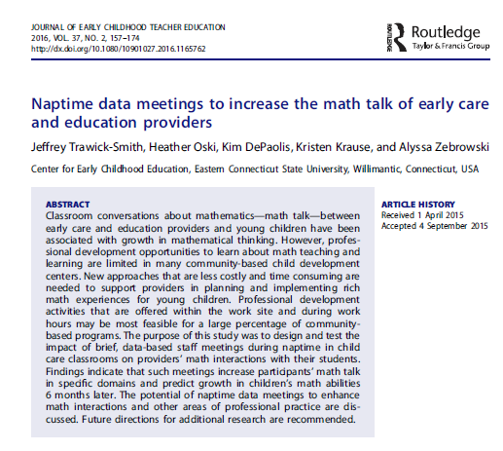
Research
Studies funded by U.S. Department of Education, Spencer Foundation, Head Start Body Start
41 students served as research assistants
30 (additional) students trained and hired to conduct child assessments
3 students conducted independent research (with faculty guidance)
13 students co-authored articles published in peer-reviewed journals

Slide 14
Area #2: Research Dissemination
Notes:
Our faculty have published in virtually every major early childhood research journal there is

Slide 15
Research Dissemination
Notes:
We produce different documents for different audiences – available for free from our website.

Slide 16
Research Dissemination
Notes:
Also make videos about our studies

Slide 17
Research Dissemination
18 students co-presented at national conferences on research findings

Slide 18
Research Dissemination
18 students co-presented at national conferences on research findings
33+ students gave presentations at student research conferences or presented posters at a CECE-sponsored conference

Slide 19
Area #3: Professional Development
Conferences
Face-to-face PD sessions
Coaching
Self-guided modules
Video
Notes:
We have provided professional development to providers in the field using a variety of methods.

Slide 20
Professional Development Projects
U.S. Navy grant
Early Reading First grant
Head Start Body Start project
Dialogic Reading for Multi-Lingual Families
Connecticut Office of Early Childhood

Slide 21
Videos
Over 100 educational videos
Notes:
Teachers, trainers, faculty and government entities from all over the world have requested permission to use our videos.

Slide 22
Videos
Over 100 educational videos
11 video series
Notes:
Many faculty in Connecticut and other states have incorporated our videos into their syllabi as required viewing

Slide 23
Videos
Over 100 educational videos
11 video series
Feature 35 teachers and providers
Notes:
We feature teachers and providers from many different kinds of settings – public preschool, community-based programs, family child care settings, home visits

Slide 24
Videos
Over 100 educational videos
11 video series
Feature 35 teachers and providers
Features many diverse families and settings

Slide 25
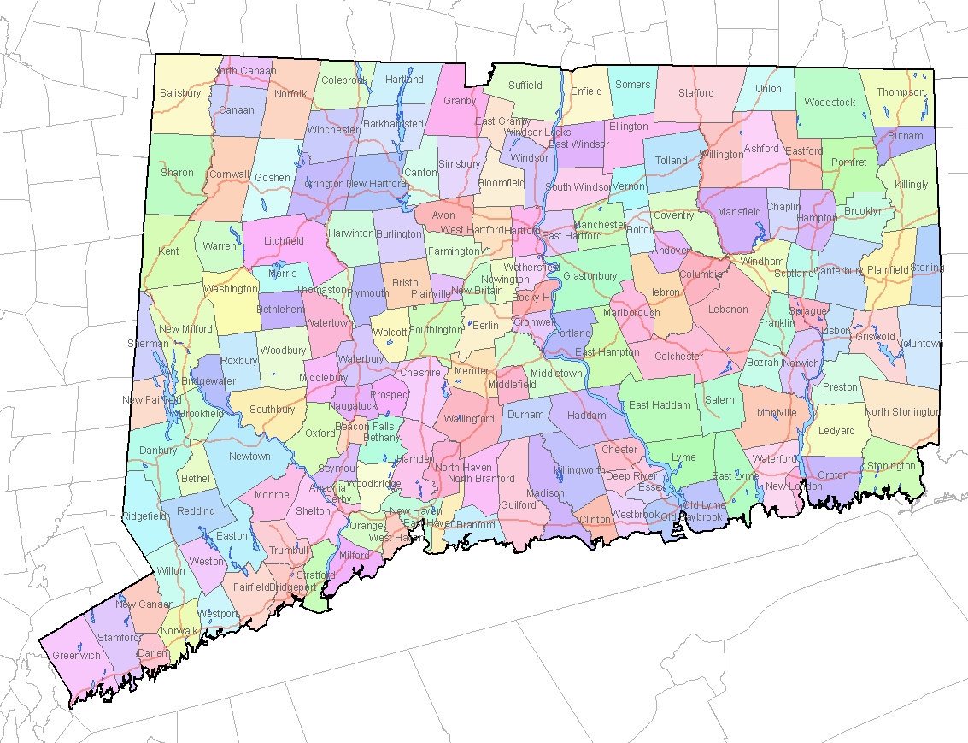
Videotaping Across CT
Notes:
We have videotaped in over 20 sites in CT and RI

Slide 26
Videos
19 Communication students have done internships

Slide 27
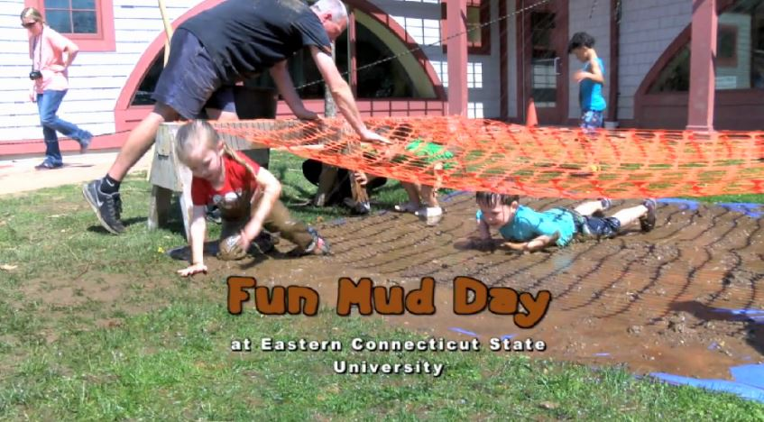
Videos
19 Communication students have done internships
ECE and PE students featured on videos
Available at:
www.easternct.edu/cece
Notes:
Show math videos

Slide 28
Videos
Over 700,000 hits/downloads
International viewing
Available on CECE website, YouTube, iTunes U

Slide 30
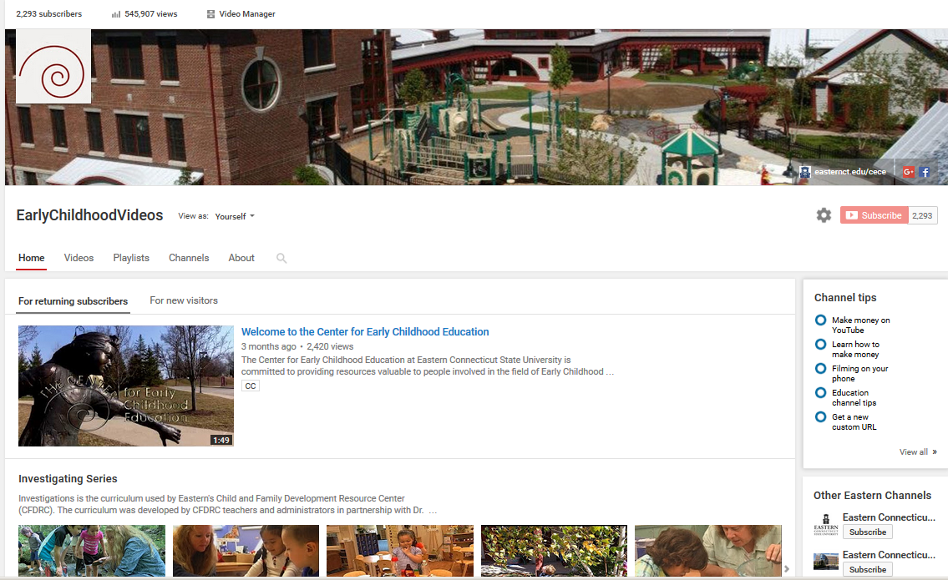
Videos
19 Communication students have done internships
ECE and Phys Ed students featured on videos
Over 700,000 hits/downloads
International viewing
Available on CECE website, YouTube, iTunes U

Slide 31
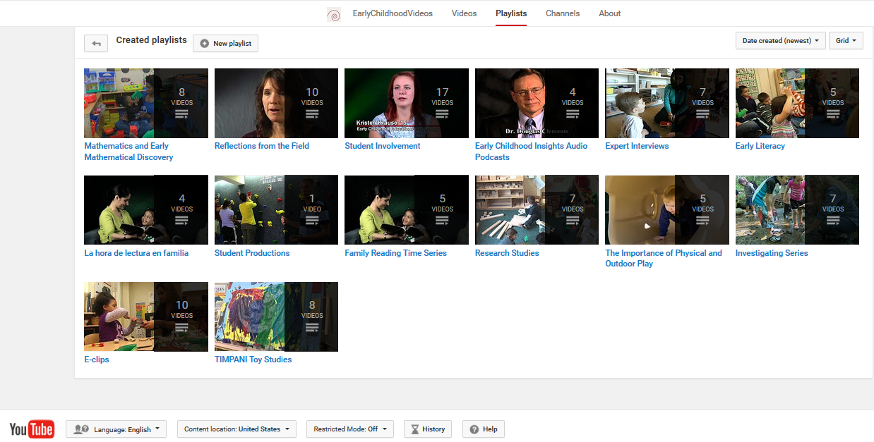
Videos
19 Communication students have done internships
ECE and Phys Ed students featured on videos
Over 700,000 hits/downloads
International viewing
Available on CECE website, YouTube, iTunes U

Slide 32
Area #4: Supporting Teacher Educators Guidance for Using Videos
More than 40 guidance documents to date

Slide 33
Supporting Teacher Educators Faculty and Trainer Video Clip Library
300 searchable video clips
342 total minutes
Sorted by 34 categories and subcategories
Notes:
These are short clips without narration so they can used to meet a faculty member’s specific needs.

Slide 34
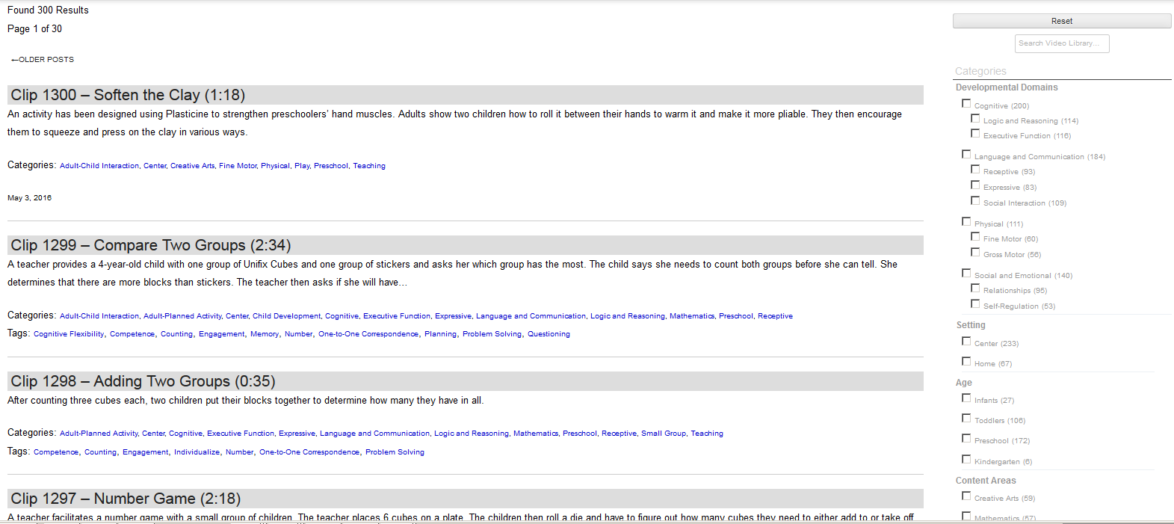
Video Clip Library
Notes:
When the library was unveiled to Connecticut ECE faculty, one of them said, “You have transformed our work!”

Slide 36
www.easternct.edu/cece
youtube.com/earlychildhoodvideos

