Slide 1


Slide 2


Purchasing Training
April 2025

Slide 3

Purchasing Thresholds
 | Under $25,000 Competitive bidding or negotiation is not required in the case of minor purchases of twenty five thousand dollars ($25,000) or less, excluding shipping and handling
 | $25,000 - $100,000 All purchases greater than $25,000 but less than or equal to $100,000 shall be made in the open market and, when possible, be based on at least three written quotations or bids from responsible and qualified sources of supply.
 | Over $100,000 Purchases that exceed $100,000 must be based, on competitive bids or proposals obtained via a sealed bid process,
 | State and Cooperative Contracts When sourcing from a state or cooperative contract you will still need the requisite quotes

Slide 4

Purchasing Web Site

Slide 5
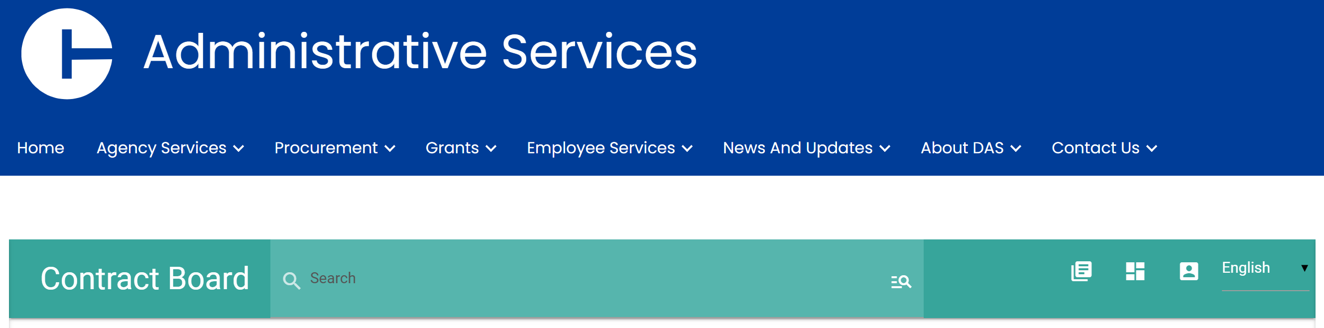



State and Cooperative Contracts

Slide 6

Purchasing Requisitions
This is the formal request for goods and services
1. Identify Need
2. Create Requisition Form: item, cost, shipping, supplier details
3. Attach Supporting Docs: quotes, justifications, specs
4. Route for Approval: Dept, VP, Purchasing
5. Notify Vendor only after PO issued

Slide 7







Requisition to Delivery
Requestion filled out and Approved
Requisition converted to a purchase order
3. Purchase order Sent to
Receiving
Vendor
Requisition Requestor
Item Received in Receiving
5. Receiving checks off item received in Banner system
Invoice Received in AP and sent to Department for approval
Department Approves Invoice and tells Ap to close if all items have been received

Slide 8
Expediting
1. Send Email to department of open po’s
2. Department should review report sent and notify purchasing if the items have been received already
3. If a blanket exists and needs to remain open let purchasing know

Slide 9



Personal Service Agreements -
PSA
Where an institution secures personal or professional services a PSA, entertainment agreement, Honorium, standard contract, or template, shall be used as the contracting method.
A PSA, standard contract, or template shall be used to contract for personal and professional services such as consultants, athletic trainers, entertainers, lecturers, and speakers.
A PSA shall not be utilized in connection with the hiring of employees or temporary staff or to compensate contractors for work which has been recognized as belonging to one of the collective bargaining units
Employee/
Independent Contractor
If it is determined that the individual would be considered an employee: the service provider shall be paid through the payroll system and will be subject to federal and state income tax withholdings and the institution shall be liable for fringe benefit expenditures

Slide 10


Eastern’s
Amazon
Account

Slide 11

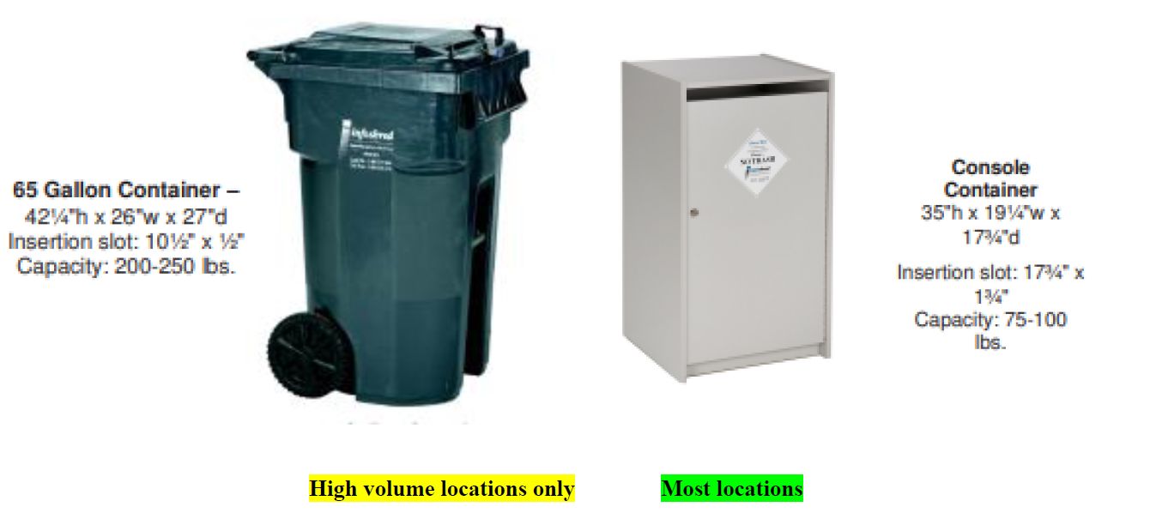
Eastern’s
Shredding
Account

Slide 12
Purchasing Web Site

Slide 13
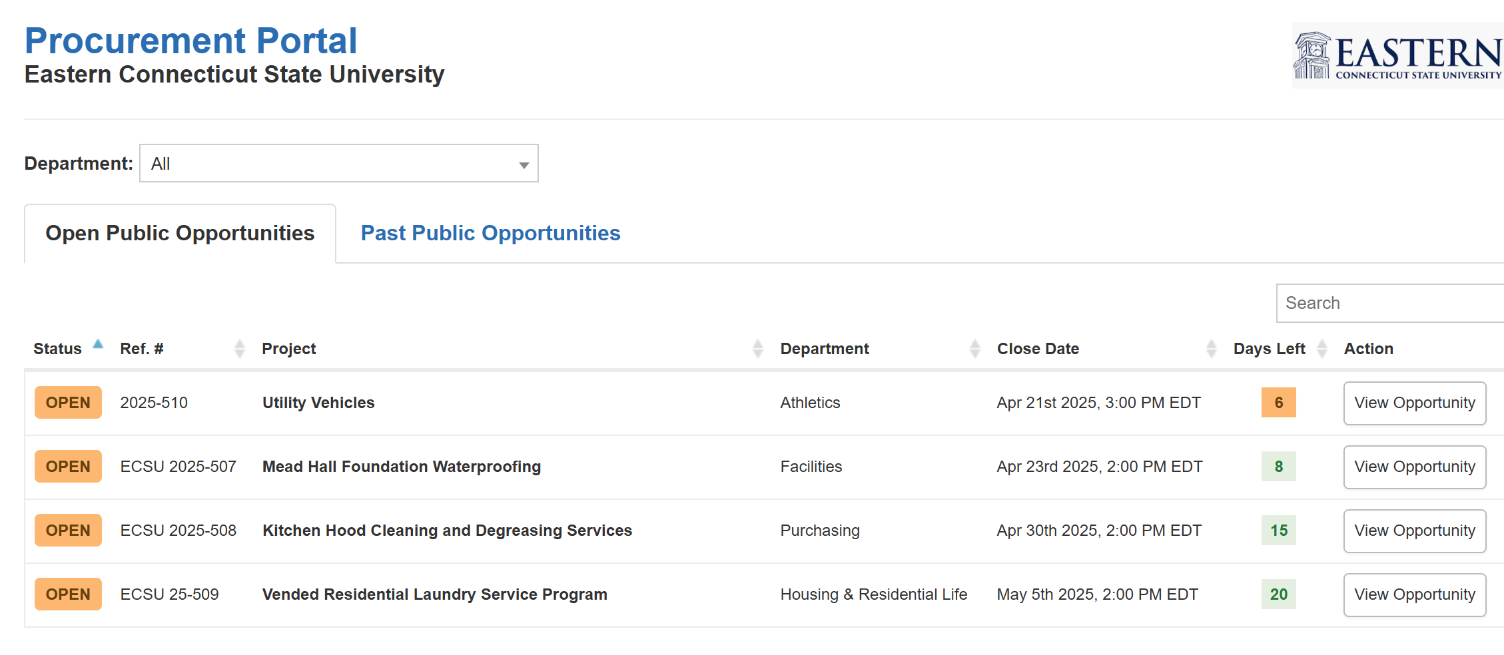


Bidding and Quoting Portal

Slide 14
End of Year
Purchasing Deadline May 19, 2025:
All FY25 requisitions for purchases must be submitted to the purchasing department no later than May 19th.
Please include all required documentation, to expedite the processing. No new requisitions or purchases should be initiated after May 19, 2025
Emergency or exception requests beyond this date must have approval from the respective department Vice President and the Vice President of Finance and Administration.
Change orders to existing POs should be submitted to purchasing by May 19, 2025
Shipping and Receiving:
All purchases for Fiscal Year 2025 must be physically on campus by June 30, 2025.
If you are notified of a shipping delay, purchasing must be notified promptly so that we can process it accordingly for year-end.
Acceptance of FY 2026 Requests
FY26 Requests will begin to be accepted in purchasing as of May 27, 2025
Processed in the first week of July. It is important to get these requests in early to purchasing.
Please ensure that the request is clearly marked FY26.

