Slide 1
AAUP, A&R, Clerical, Engineering/Scientific, Management & Confidential, and SUOAF
Self Service
Time and Attendance
Training
Revised 10/16/20

Slide 2
How to Log In to Core-CT
This is a web-based system that can be accessed at: http://www.core-ct.state.ct.us
Your Username is your 6-digit State of Connecticut Employee ID that is listed on your biweekly paycheck or advice of deposit form.

Slide 3
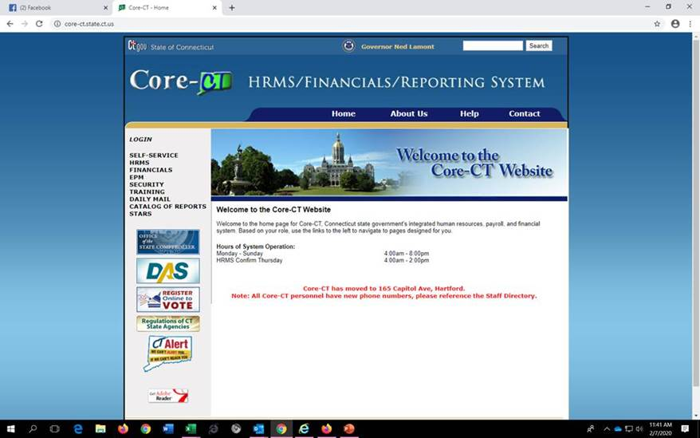
Click on the link to Core-CT http://www.core-ct.state.ct.us
Click Login on the left side of the page

Slide 4
Enter your User ID and Password and click Sign In

Slide 5
How to Enter Your Timesheet in Core-CT
Bi-weekly timesheets which include all hours must be submitted by the close of business on the Thursday of each pay week.
Hours must be entered in increments of .25 (i.e. 5.25 hours, 5.50 hours, 5.75 hours) and can be submitted at the end of your shift each day.
Your supervisor must approve your timesheet by the close of business on the Friday of each pay week.
It is your responsibility to enter all hours worked on your timesheet by 8 pm on the Thursday of the pay week and to make sure that your supervisor approves it by the close of business on the next day.
The only way to be certain you will receive a paycheck is to submit your timesheet and make sure that it is approved by your supervisor.

Slide 6
Important things to remember …
Time must be submitted in a minimum of .25 hour increments.
It is STRONGLY RECOMMENDED that you submit your time on a daily basis.
Before a timesheet can be approved, it must be processed by the system overnight.
If a change is made to the timesheet it must be processed overnight again before it can be approved by your supervisor.
If you make a change to your timesheet, after your supervisor has already approved your timesheet, you must inform your supervisor that a change has been made so that it can run through the nightly cycle and be approved again by your supervisor.

Slide 7
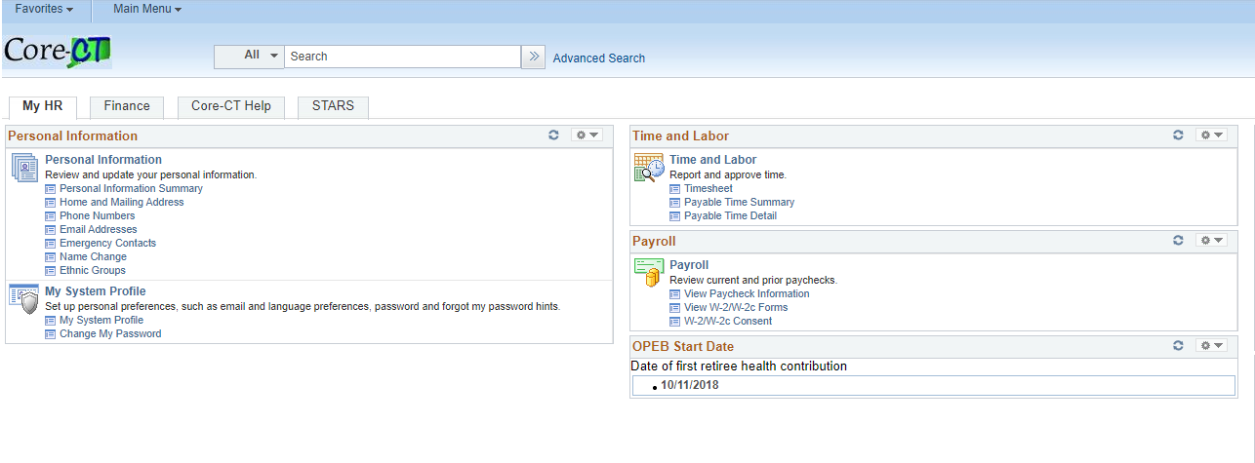
Login to CORE-CT (see previous slides if necessary). The Home page displays. Click on Timesheet under the Time and Labor Menu.
You can also go to Main Menu→Core-CT HRMS→Self Service→Time Reporting→Report Time→Timesheet

Slide 8
A timesheet displays for the pay period. If the correct pay period is not displayed, click on the calendar icon next to the date field and select the correct date for the first day of the pay period (the Friday after Pay Day).

Slide 9
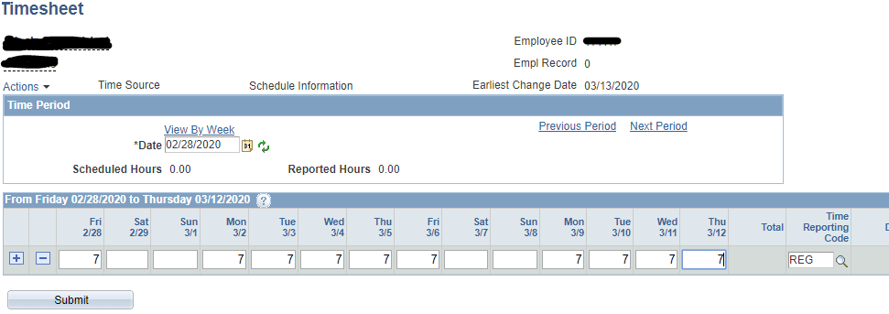
The holidays for the pay period will be highlighted in yellow. Enter the regular hours you worked with the Time Reporting Code (TRC) of REG.

Slide 10
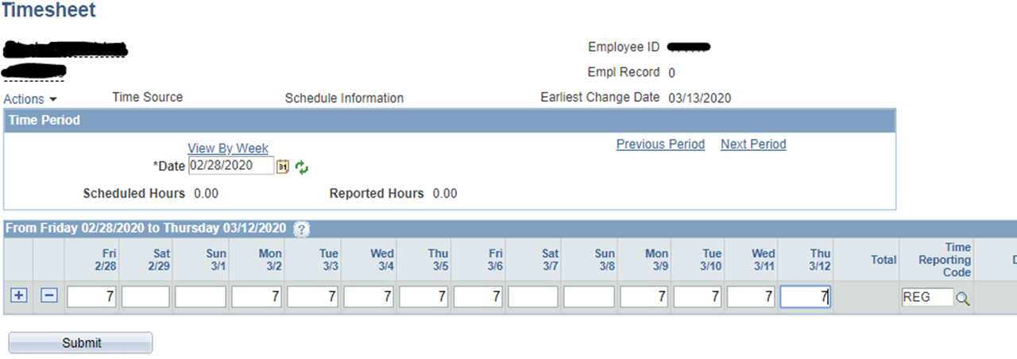
If you used vacation time, personal leave, sick time, or other leave codes click the + arrow to add another row. If there was a holiday for the pay period also click the + arrow to add another row.

Slide 11
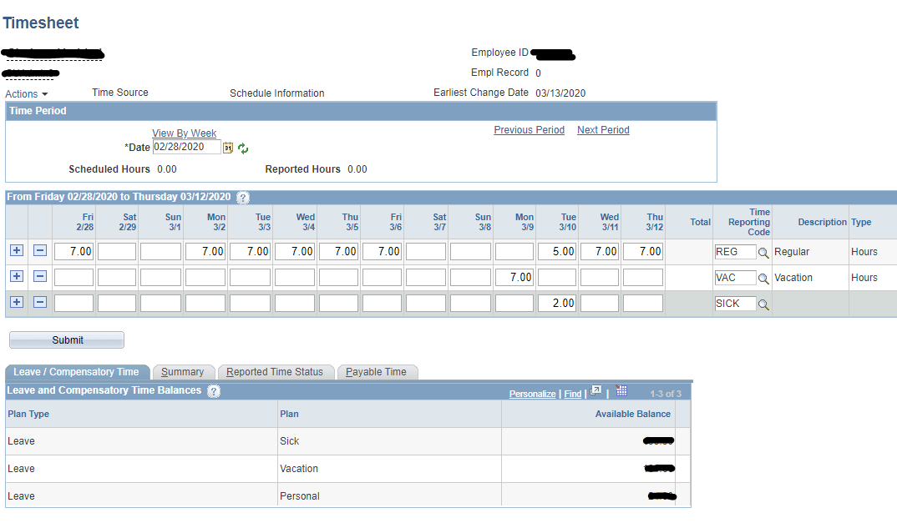
Enter the additional Time Reporter Codes used (at the end of the PowerPoint) and the hours. The leave balances will display on the bottom of the screen. An additional line will need to be added for each TRC used.

Slide 12
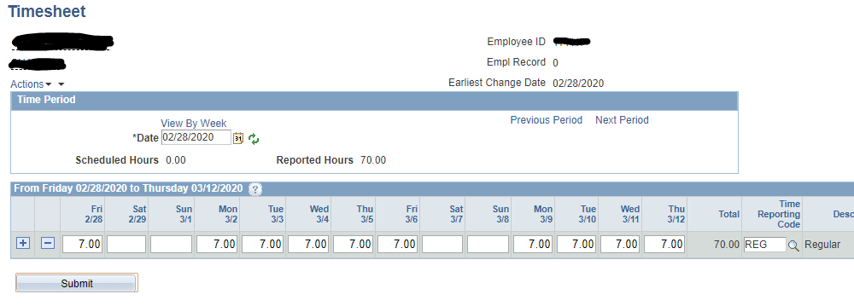
At the end of the pay period make sure the reported hours equal your hours worked. Once you have entered all your time and reviewed it click Submit.

Slide 13
How to View Payable Time after Submission
Once you have submitted your timesheet and it has processed overnight, you may view your hours and the status of your timesheet through the Payable Time Detail link.
This is how you will be able to see if your supervisor has approved your timesheet.

Slide 14
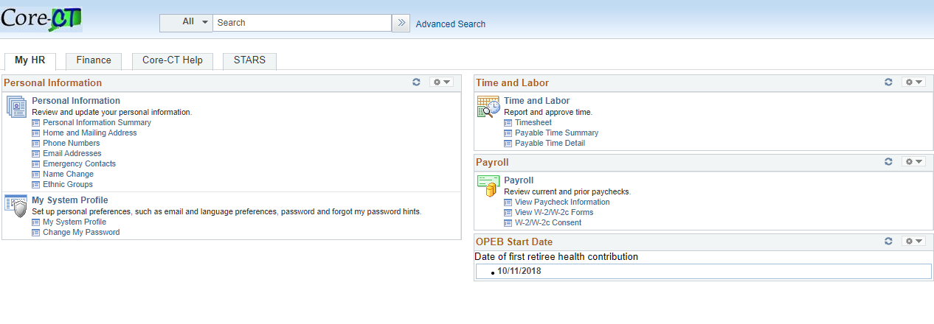
Login to CORE-CT (see previous slides if necessary). The Home page displays. Click on Payable Time Detail under the Time and Labor Menu.

Slide 15
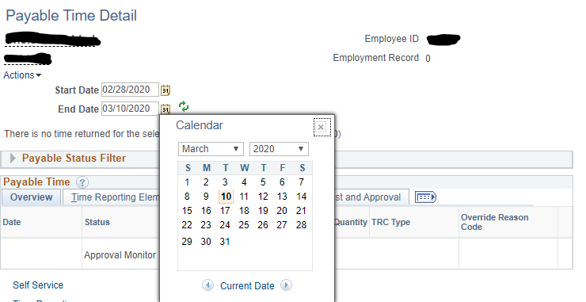
Click on the calendar next to the Start Date and select the first day of the pay period (Friday after Pay Day). Click on the calendar next to the End Date and select the last day of the pay period (Pay Day Thursday). Then click the Get Rows button.
Notes:
Enter Start Date and End Date of current pay period.

Slide 16
Verify that all hours submitted are listed on the Payable Time Detail. A status of “Needs Approval” indicates your supervisor has not yet approved your timesheet. Once the timesheet has been approved the status should reflect “Approved – Goes to Payroll”.

Slide 17
Overall Reminders about Core-CT Self Service
You must submit all hours worked on a timesheet every pay period by 8 pm on the Thursday of pay week.
Report all time worked on your timesheet in increments of .25. You may enter hours worked at the end of your shift each day.
It is your responsibility to enter all hours worked on your timesheet by 8 pm on the Thursday of the pay week and to make sure that your supervisor approves it by the close of business on the Friday of the pay week.
We suggest that you set a recurring reminder on your Outlook calendar, or on your cell phone, for every other Thursday (Pay Day) to submit your timesheet.
You can submit your time on a daily basis or at the end of every pay period.
We suggest that you add the Core-CT log-in page to your favorites on your desktop.
Core-CT hours of operation are 4:00 am to 8:00 pm Monday-Sunday
Core-CT is not available after 2 p.m. every other Thursday (“The non pay day”) due to payroll processing.

Slide 18
For Assistance….
Call
860-465-5746
Email
payroll@easternct.edu
Visit the Website
https://www.easternct.edu/fiscal-affairs/payroll.html
Password Resets
For password resets email payroll at payroll@easternct.edu.
All requests must come from an Eastern email.

Slide 19
CORE-CT TIME REPORTER CODES - AAUP - 10 Month
TRC | DESCRIPTION | ORC | ORC DESCRIPTION
REG | REGULAR HOURS
REGTC | REGULAR HOURS TELECOMMUTING | TCC19 | TELECOMMUTING - COVID 19
HOL | HOLIDAY
SICK | SICK
SFAM | SICK FAMILY
SP | SICK MEDICAL APPOINTMENT
SFFNR | SICK FUNERAL - IMMEDIATE FAMILY
SFNRL | SICK FUNERAL - NON-IMMEDIATE FAMILY
PL | PERSONAL LEAVE
LCVCF | OTHER LEAVE - CONFERENCE/CONVENTION
LWWTR | WINTER WEATHER CLOSURE
LPRTY | UNION LEAVE - PARTY/LUNCHEON
LUBLP | UNION LEAVE - BUSINESS
LSABP | SABBATICAL LEAVE PAID
LSUMR | SUMMER RECESS PAID
Please note: -If you are using the Family Medical Leave Act (FMLA or Worker Comp, the TRC will be provided by Human Resources after you have submitted the paperwork. -If you need any TRC's not listed or have questions, please email Payroll@easternct.edu for assistance.

Slide 20
CORE-CT TIME REPORTER CODES - AAUP - 12 Month
TRC | DESCRIPTION | ORC | ORC DESCRIPTION
REG | REGULAR HOURS
REGTC | REGULAR HOURS TELECOMMUTING | TCC19 | TELECOMMUTING - COVID 19
HOL | HOLIDAY
HWCE | HOLIDAY WORKED COMP EARNED
HCU | HOLIDAY COMP USED
SICK | SICK
SFAM | SICK FAMILY
SP | SICK MEDICAL APPOINTMENT
SFFNR | SICK FUNERAL - IMMEDIATE FAMILY
SFNRL | SICK FUNERAL - NON-IMMEDIATE FAMILY
PL | PERSONAL LEAVE
VAC | VACATION
VS | VACATION IN LIEU OF SICK
LCVCF | OTHER LEAVE - CONFERENCE/CONVENTION
LWWTR | WINTER WEATHER CLOSURE
LPRTY | UNION LEAVE - PARTY/LUNCHEON
LUBLP | UNION LEAVE - BUSINESS
Please note:
-If you are using the Family Medical Leave Act (FMLA or Worker Comp, the TRC will be provided by Human Resources after you have submitted the paperwork. - If you work a Holiday, two line entries are needed. (1) HOL and (2) HWCE indicating the hours worked. - If you need any TRC's not listed or have questions, please email Payroll@easternct.edu for assistance.

Slide 21
A&R CORE-CT TIME REPORTER CODES
TRC | DESCRIPTION | ORC | Override Reason Code Description
REG | REGULAR HOURS
REGTC | REGULAR HOURS TELECOMMUTING | TCC19 | TELECOMMUTING DUE TO COVID-19
HOL | HOLIDAY
SICK | SICK HOURS - EMPLOYEE
SFAM | SICK HOURS - FAMILY SICK
SP | SICK HOURS - DOCTOR APPT
SFFNR | SICK FUNERAL - IMMEDIATE FAMILY
SFNRL | SICK FUNERAL - NON-IMMEDIATE FAMILY
PL | PERSONAL LEAVE
VAC | VACATION
VS | VACATION IN LIEU OF SICK LEAVE
LWWTR | WINTER WEATHER CLOSURE
OVT | OVERTIME
CCE | COMP TIME EARNED (Essential Employees)
HWCE | HOLIDAY WORKED - COMP EARNED
HYPY | HOLIDAY WORKED - PAID
CU | COMP TIME USED
HCU | HOLIDAY COMP USED
LPRTY | UNION PARTY
LUBLP | UNION BUSINESS LEAVE
Please note:
-If you are out using the Family Medical Leave Act (FMLA) or Workers Comp the TRC will be provided by Human Resources after you have submitted the paperwork.
- If you need any additional TRC’s or have questions about which to use please contact Payroll at 860-465-5746.
-If you work over 40 hours for the pay week code OVT should be used for the hours over the first 40 hours for that pay week.
-If you work on a holiday, two lines will need to be entered on the timesheet. The total number of hours worked on the holiday will be entered with code HWCE to earn comp time. Half of the hours worked will be entered on another line with code HYPY which will be paid.
-If you are an essential employee and work during winter weather you will use code CCE for those hours to earn comp time for those hours.

Slide 22
CLERICAL CORE-CT TIME REPORTER CODES
TRC | DESCRIPTION | ORC | Override Reason Code Description
REG | REGULAR HOURS
REGTC | REGULAR HOURS TELECOMMUTING | TCC19 | TELECOMMUTING DUE TO COVID-19
HOL | HOLIDAY
SICK | SICK HOURS - EMPLOYEE
SFAM | SICK HOURS - FAMILY SICK
SP | SICK HOURS - DOCTOR APPT
SFFNR | SICK FUNERAL - IMMEDIATE FAMILY
SFNRL | SICK FUNERAL - NON-IMMEDIATE FAMILY
PL | PERSONAL LEAVE
VAC | VACATION
VS | VACATION IN LIEU OF SICK LEAVE
OVT | OVERTIME
LWWTR | WINTER WEATHER CLOSURE
HWCE | HOLIDAY WORKED, COMP EARNED
HPWP | HOLIDAY WORKED AND PAID
HCU | HOLIDAY COMP USED
LPRTY | UNION PARTY
LUBLP | UNION BUSINESS LEAVE
Please note:
-If you are out using the Family Medical Leave Act (FMLA) or Workers Comp the TRC will be provided by Human Resources after you have submitted the paperwork.
- If you need any additional TRC’s or have questions about which to use please contact Payroll at 860-465-5746.
-If you work over 8 hours in a day use code OVT for the additional hours.
- If you work on a holiday code HWCE should be used to earn comp time for the holiday or code HPWP should be used to be paid for the holiday.

Slide 23
MANAGEMENT CONFIDENTIAL CORE-CT TIME REPORTER CODES
TRC | DESCRIPTION | ORC | Override Reason Code Description
REG | REGULAR HOURS
REGTC | REGULAR HOURS TELECOMMUTING | TCC19 | TELECOMMUTING DUE TO COVID-19
HOL | HOLIDAY
HWCE | HOLIDAY WORKED - COMP EARNED
HCU | HOLIDAY COMP USED
SICK | SICK HOURS - EMPLOYEE
SFAM | SICK HOURS - FAMILY SICK
SP | SICK HOURS - DOCTOR APPT
SFFNR | SICK FUNERAL - IMMEDIATE FAMILY
SFNRL | SICK FUNERAL - NON-IMMEDIATE FAMILY
PL | PERSONAL LEAVE
VAC | VACATION
VS | VACATION USED IN LIEU OF SICK
LCVCF | OTHER LEAVE - CONVENTION/CONFERENCE
LWWTR | WINTER WEATHER CLOSURE
OVT | OVERTIME - Non-exempt EE's only
Please note:
-If you are out using the Family Medical Leave Act (FMLA) or Workers Comp the TRC will be provided by Human Resources after you have submitted the paperwork.
-If you need any additional TRC’s or have questions about which to use please contact Payroll at
860-465-5746.
-If you are a non-exempt employee and work over 40 hours for the pay week then code OVT should be used for the hours over the first 40 hours for that pay week.
-If you work on a holiday comp time is earned – The Time Reporting Code HWCE will be used.

Slide 24
ENGINEERING/SCIENTIFIC CORE-CT TIME REPORTER CODES
TRC | DESCRIPTION | ORC | Override Reason Code Description
REG | REGULAR HOURS
REGTC | REGULAR HOURS TELECOMMUTING | TCC19 | TELECOMMUTING DUE TO COVID-19
HOL | HOLIDAY
SICK | SICK HOURS - EMPLOYEE
SFAM | SICK HOURS - FAMILY SICK
SP | SICK HOURS - DOCTOR APPT
SFFNR | SICK FUNERAL - IMMEDIATE FAMILY
SFNRL | SICK FUNERAL - NON-IMMEDIATE FAMILY
PL | PERSONAL LEAVE
VAC | VACATION
VS | VACATION IN LIEU OF SICK LEAVE
LCVCF | OTHER LEAVE - CONVENTION/CONFERENCE
LWWTR | WINTER WEATHER CLOSURE
IFILR | USED FOR 1ST 5 HOURS WORKED OVER SCHEDULE (Hours 36-40)
CCE | COMP TIME EARNED (OVER 5 EXTRA HRS WORKED – Hours 41+)
HWCE | HOLIDAY WORKED, COMP EARNED 1:1
CU | COMP TIME USED
HCU | HOLIDAY COMP USED
OVT | OVERTIME - Non-exempt employees
OTST | OVERTIME STRAIGHT TIME - Non-exempt employees
LPRTY | UNION LUNCHEON
LUBLP | UNION BUSINESS LEAVE
Please note:
-If you are out using the Family Medical Leave Act (FMLA) or Workers Comp the TRC will be provided by Human Resources after you have submitted the paperwork.
- If you need any additional TRC’s or have questions about which to use please contact Payroll at 860-465-5746.
-If you are an exempt employee if you work more than your regular 7 hours for the day you will use code IFILR for the first five extra hours during the pay week. If you go over an additional five hours in the pay week you will use code CCE for those hours.
-If you are a non-exempt employee and you work more than 35 hours but less than 40 hours for the pay week you will enter the additional hours using code IFILR.
-If you are a non-exempt employee and you work more than 40 hours for the pay week you will enter the first five additional hours using code OTST. For the hours over the additional five hours you will use code OVT.
- If you work a holiday, code HWCE should be used – you do not need to use code IFILR for the first five hours but these hours count towards the first five hours worked.

Slide 25
SUOAF CORE-CT TIME REPORTER CODES
TRC | DESCRIPTION | ORC | Override Reason Code Description
REG | REGULAR HOURS
REGTC | REGULAR HOURS TELECOMMUTING | TCC19 | TELECOMMUTING DUE TO COVID-19
HOL | HOLIDAY
SICK | SICK HOURS - EMPLOYEE
SFAM | SICK HOURS - FAMILY SICK
SP | SICK HOURS - DOCTOR APPT
SFFNR | SICK FUNERAL - IMMEDIATE FAMILY
SFNRL | SICK FUNERAL - NON-IMMEDIATE FAMILY
PL | PERSONAL LEAVE
VAC | VACATION
VS | VACATION IN LIEU OF SICK LEAVE
LCVCF | OTHER LEAVE - CONVENTION/CONFERENCE
LWWTR | WINTER WEATHER CLOSURE
IFILR | USED FOR 1ST 5 HOURS WORKED OVER SCHEDULE (Hours 36-40)
CCE | COMP TIME EARNED (OVER 5 EXTRA HRS WORKED – Hours 41+)
HWCE | HOLIDAY WORKED, COMP EARNED 1:1
CU | COMP TIME USED
HCU | HOLIDAY COMP USED
OVT | OVERTIME - Non-exempt employees (Hours 41+)
OTST | OVERTIME STRAIGHT TIME - Non-exempt employees (Hours 36-40)
LPRTY | UNION LUNCHEON
LUBLP | UNION BUSINESS LEAVE
Please note:
-If you are out using the Family Medical Leave Act (FMLA) or Workers Comp the TRC will be provided by Human Resources after you have submitted the paperwork.
- If you need any additional TRC’s or have questions about which to use please contact Payroll at 860-465-5746.
-If you are an exempt employee if you work more than your regular 7 hours for the day you will use code IFILR for the first five extra hours during the pay week. If you go over an additional five hours in the pay week you will use code CCE for those hours.
-If you are a non-exempt employee and you work more than 35 hours but less than 40 hours for the pay week you will enter the additional hours using code IFILR.
-If you are a non-exempt employee and you work more than 40 hours for the pay week you will enter the first five additional hours using code OTST. For the hours over the additional five hours you will use code OVT.
- If you work a holiday, code HWCE should be used – you do not need to use code IFILR for the first five hours but these hours count towards the first five hours worked.

