Slide 1
Student Worker and University Assistant Self Service
Time and Attendance
Training
Revised 2/13/20

Slide 2
How to Log In to Core-CT
This is a web-based system that can be accessed at: http://www.core-ct.state.ct.us
Your Username is your 6-digit State of Connecticut Employee ID that is listed on your biweekly paycheck or advice of deposit form.

Slide 3
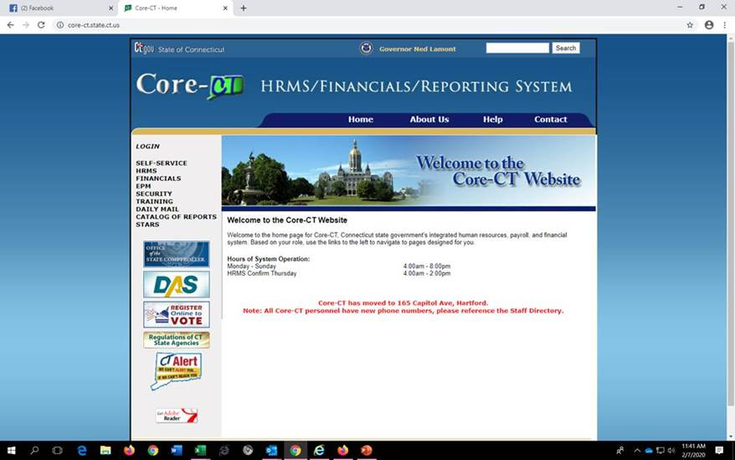
Click on the link to Core-CT http://www.core-ct.state.ct.us
Click Login on the left side of the page

Slide 4
Enter your username and password and click Sign In

Slide 5
How to Enter Your Timesheet in Core-CT
Bi-weekly timesheets which include all hours must be submitted by the close of business on the Thursday of each pay week.
Hours must be entered in increments of .25 (i.e. 5.25 hours, 5.50 hours, 5.75 hours) and can be submitted at the end of your shift each day.
Your supervisor must approve your timesheet by the close of business on the Friday of each pay week.
It is your responsibility to enter all hours worked on your timesheet by 8 pm on the Thursday of the pay week and to make sure that your supervisor approves it by the close of business on the next day.
If you don’t submit a timesheet and make sure that it is approved by your supervisor then a paycheck will not be generated.

Slide 6
Important things to remember …
Time must be submitted in a minimum of .25 hour increments.
It is STRONGLY RECOMMENDED that you submit your time on a daily basis.
Before a timesheet can be approved it must be processed by the system overnight.
If a change is made to the timesheet it must be processed overnight again before it can be approved by your supervisor.
If you make a change to your timesheet after your supervisor has already approved your timesheet, you must inform your supervisor that a change has been made so that it can run through the nightly cycle and be approved again by your supervisor.

Slide 7
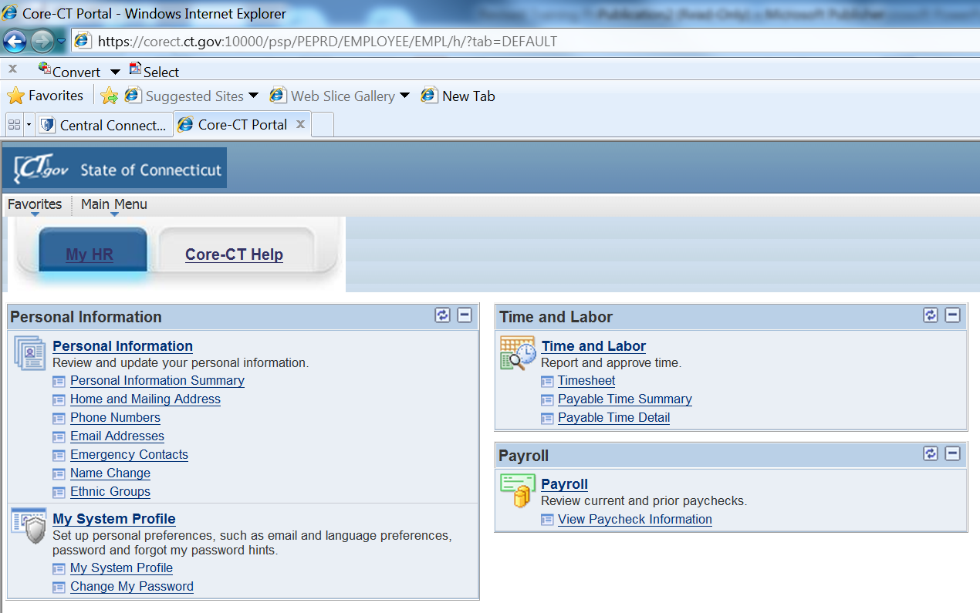
Login to CORE-CT (see previous slides if necessary). The Home page displays. Click on Timesheet under the Time and Labor Menu.

Slide 8
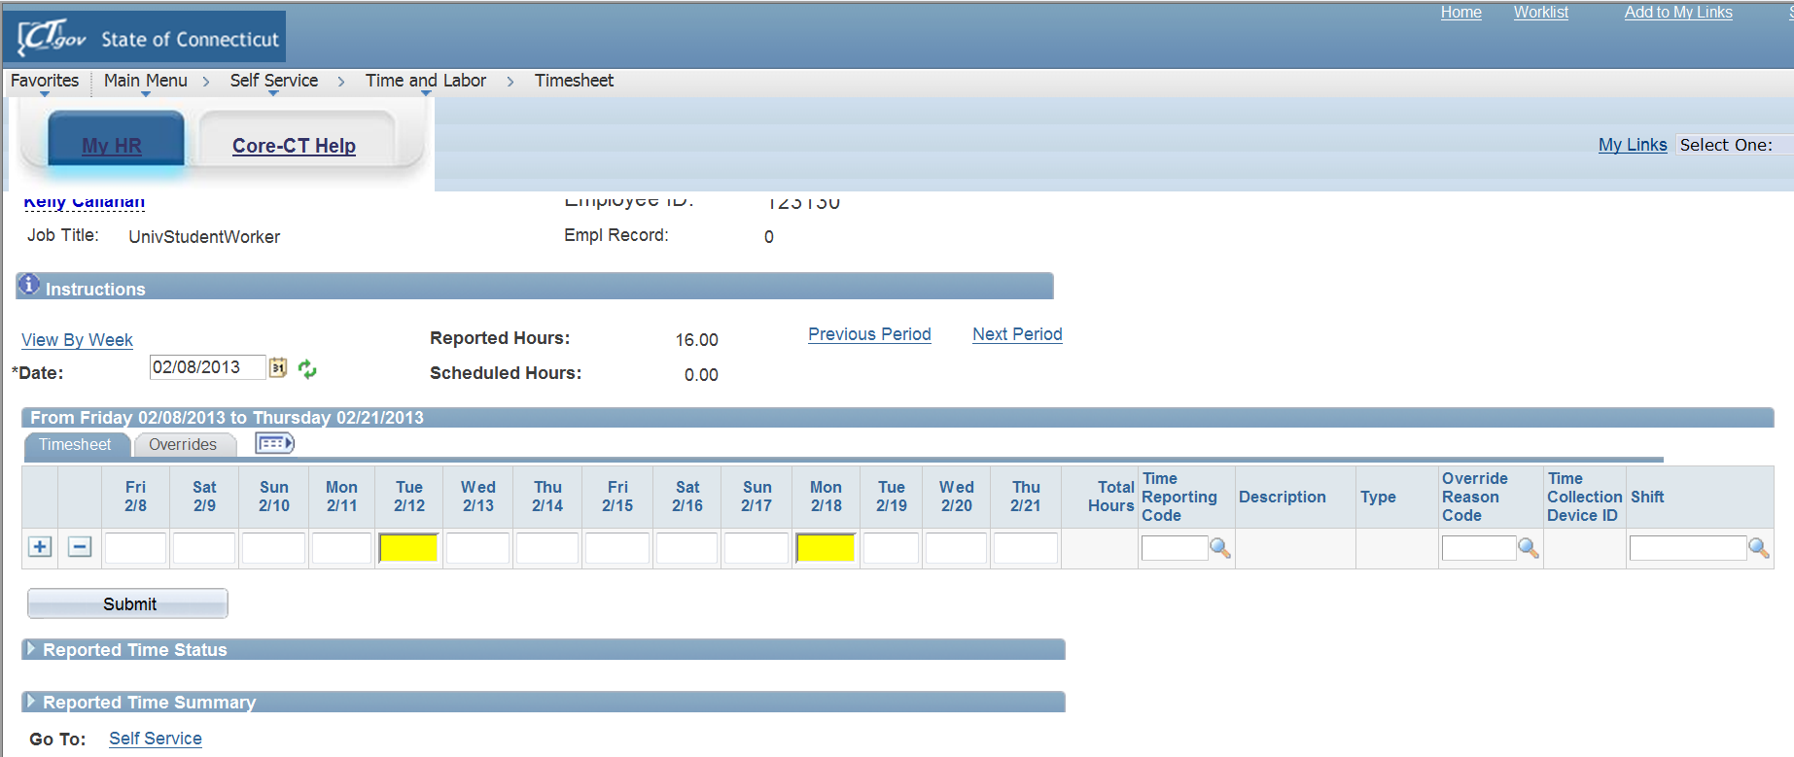
A blank timesheet displays for the entire pay period. If the correct pay period is not displayed, click on the calendar icon next to the date field and select the correct date for the first day of the pay period (the Friday after Pay Day).

Slide 9
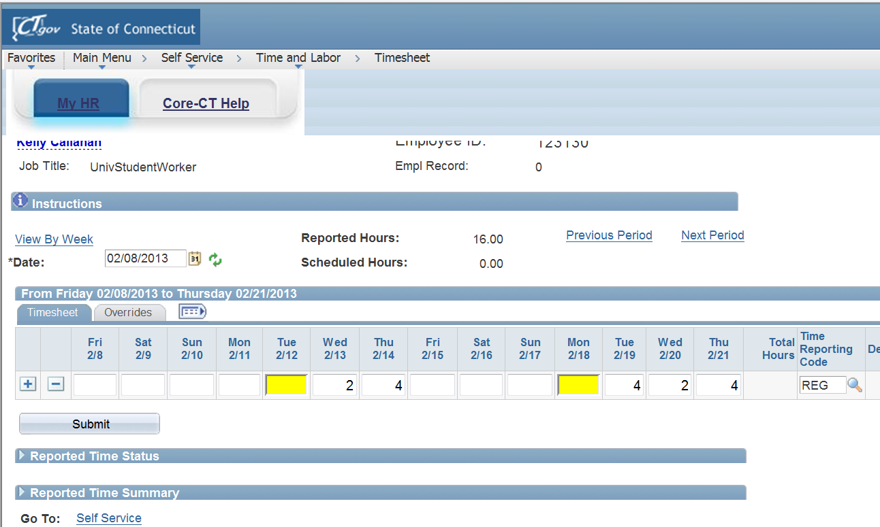
Enter the number of hours worked in the box under the appropriate date(s) you worked during the pay period. Under Time Reporting Code enter “REG” into the box. Review your hours to make sure what you have entered is correct. Make fixes if necessary. Click Submit.

Slide 10
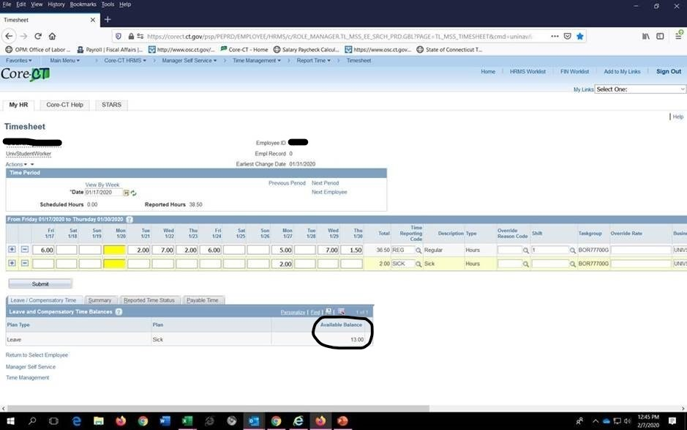
If you need to enter sick time hit the plus button to the right to add a row. Sick time must be used in 1 hour increments. In order to use sick time you must have an available balance which shows on the bottom of the screen.

Slide 11
How to View Payable Time after Submission
Once you have submitted your timesheet and it has processed overnight, you may view your hours and the status of your timesheet through the Payable Time Detail link.
This is how you will be able to see if your supervisor has approved your timesheet.

Slide 12
Login to CORE-CT (see previous slides if necessary). The Home page displays. Click on Payable Time Detail under the Time and Labor Menu.

Slide 13
Click on the calendar next to the Start Date and select the first day of the pay period (Friday after Pay Day). Click on the calendar next to the End Date and select the last day of the pay period (Pay Day Thursday). Then click the Get Rows button.
Notes:
Enter Start Date and End Date of current pay period.

Slide 14
Verify that all hours submitted are listed on the Payable Time Detail. A status of “Needs Approval” indicates your supervisor has not yet approved your timesheet. Once the timesheet has been approved the status should reflect “Approved – Goes to Payroll”.

Slide 15
Overall Reminders about Core-CT Self Service
You must submit all hours worked on a timesheet every pay period by 8 pm on the Thursday of pay week.
Report all time worked on your timesheet in increments of .25. You may enter hours worked at the end of your shift each day.
It is your responsibility to enter all hours worked on your timesheet by 8 pm on the Thursday of the pay week and to make sure that your supervisor approves it by the close of business on the Friday of the pay week.
We suggest that you set a recurring reminder on your Outlook calendar, or on your cell phone, for every other Thursday (Pay Day) to submit your timesheet.
We suggest that you add the Core-CT log-in page to your favorites on your desktop.
Core-CT hours of operation are 4:00 am to 8:00 pm Monday-Sunday
Core-CT is not available after 2 p.m. every other Thursday (“The non pay day”) due to payroll processing.

Slide 16
For Assistance….
Call
860-465-5746
Email
payroll@easternct.edu
Visit the Website
https://www.easternct.edu/fiscal-affairs/payroll.html
Password Resets
For password resets email payroll at payroll@easternct.edu.
All requests must come from an Eastern email.

