Slide 1

How to login to Core-CT for the first time and setting up/using the forgotten password help
Revised 2/13/20

Slide 2
How to Log In to Core-CT
This is a web-based system that can be accessed at: http://www.core-ct.state.ct.us
All employees are sent an email containing their Core-CT Username and temporary Password.
Your Username is your 6-digit State of Connecticut Employee ID that is listed on your biweekly paycheck or advice of deposit form.

Slide 3
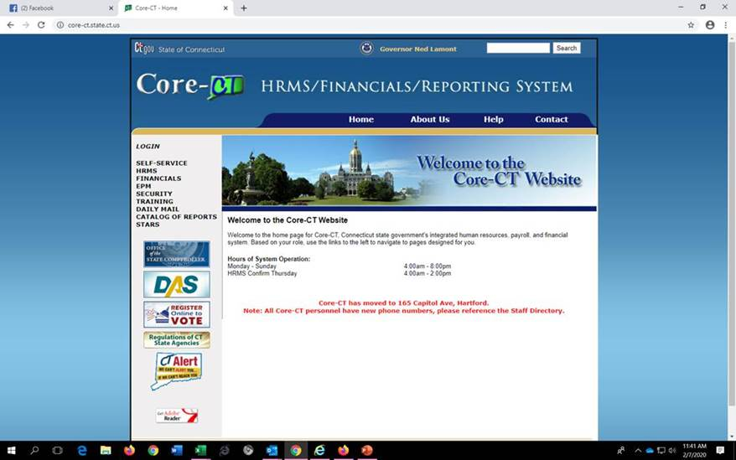
Click on the link to Core-CT http://www.core-ct.state.ct.us
Click Login on the left side of the page

Slide 4
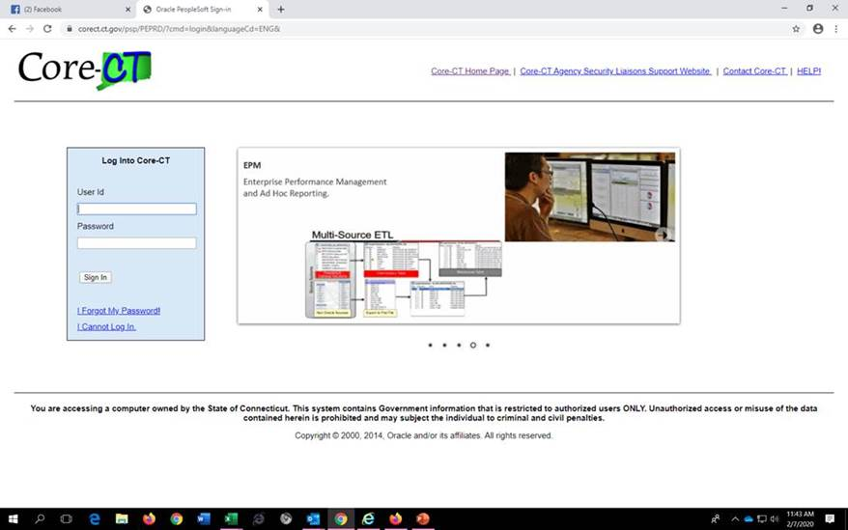
Enter User ID and temporary Password that were emailed to you from Human Resources then click on Sign In:

Slide 5
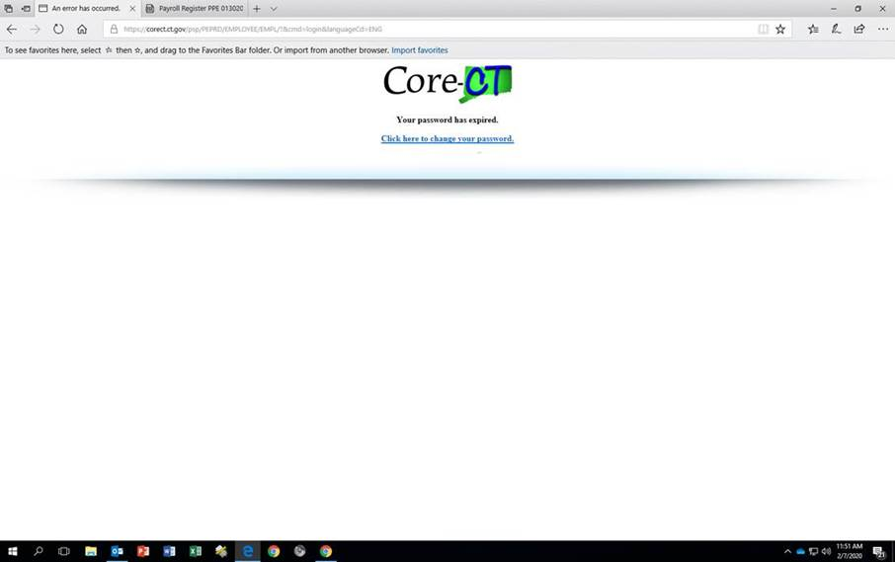
You will be prompted to change your password. Select “Click here to change your password.”

Slide 6
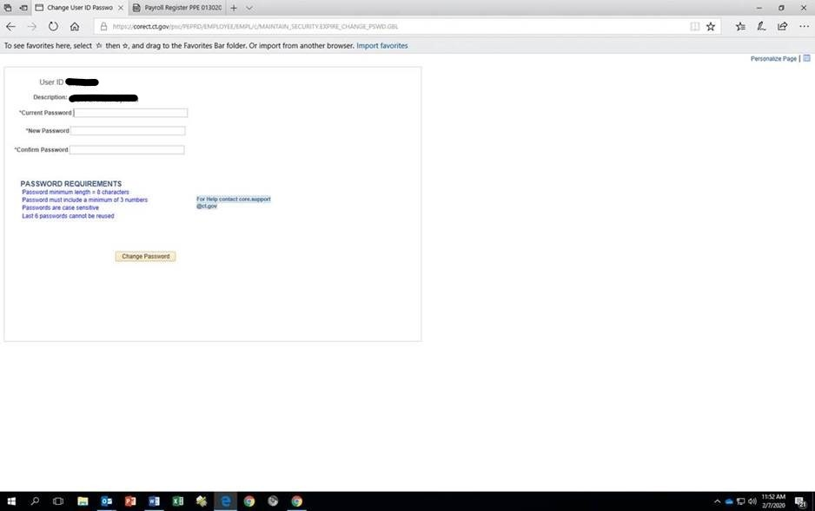
The Change Password page displays. Enter the temporary password (that was emailed to you) in the Current Password field. Enter a new password and confirm it. Click the Change Password button. ( See new password requirements below).

Slide 7
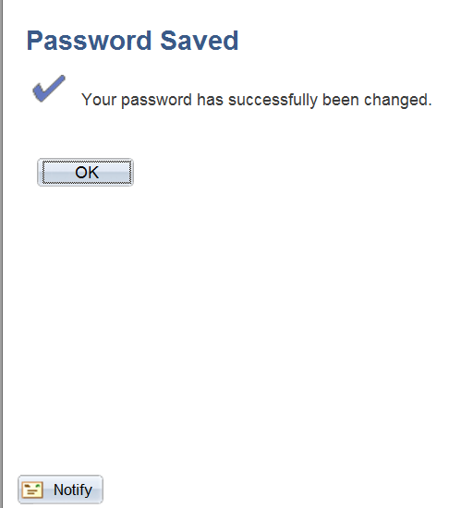
You will receive a confirmation screen stating that your Password has been Saved. Click OK. (You will need to remember this password and use it each time you login to Core-CT.)

Slide 8
How to setup and use forgotten password help
The first time you login to Core-CT, you must set up the forgotten password help. You will need this in case you forget your password in the future.

Slide 9
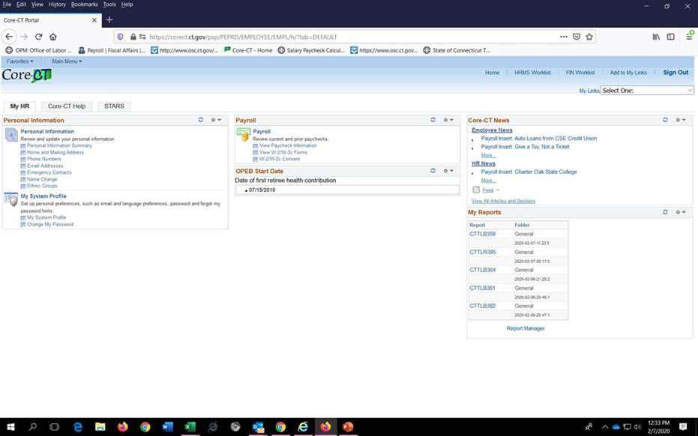
To set up password reset process, login to CORE-CT. Click the My System Profile link on the left hand side

Slide 10
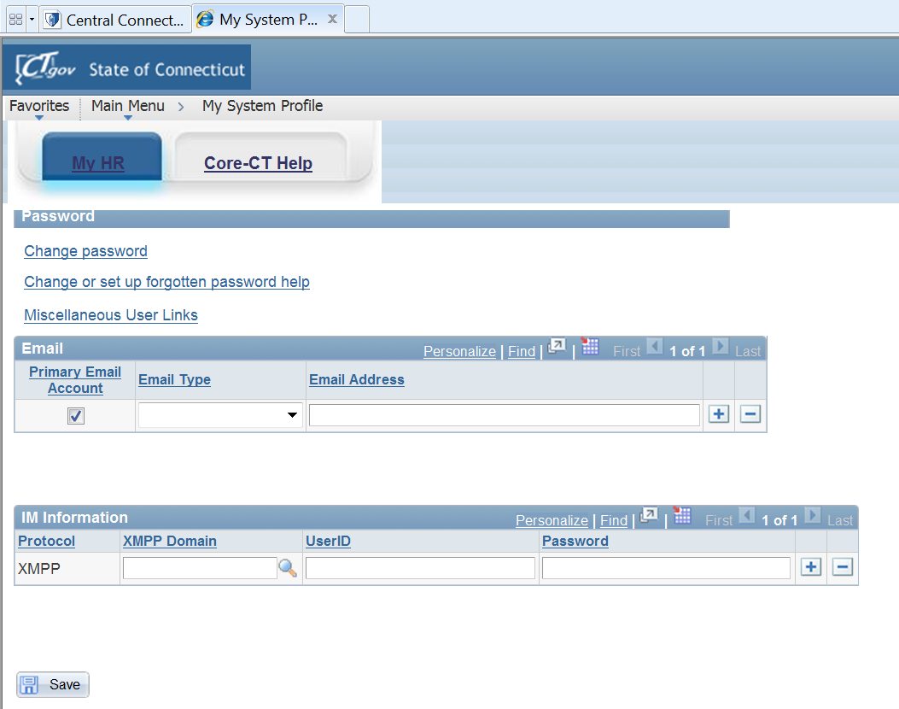
Verify that a valid e-mail address is entered in the e-mail box. Make any corrections if necessary and click Save. If you forget your password, it will be emailed to this email address.

Slide 11
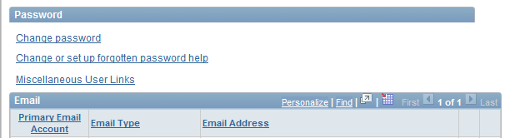
Click the Change or set up forgotten password help link.

Slide 12
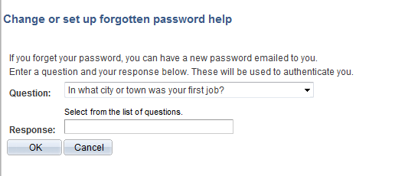
Click the Question drop down list and select a question to answer.

Slide 13
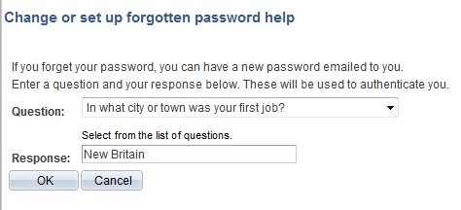
Enter a Response (not case sensitive). Click the OK button. You have now completed setting up the forgotten password help process.

Slide 14
To use the password reset feature because you have forgotten your password, go to the Core-CT login page. Click the I Forgot my Password link on the sign-in page.

Slide 15
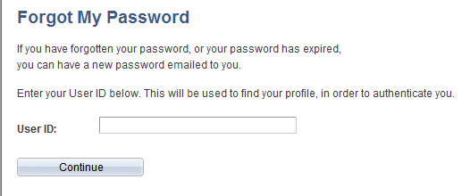
The Forgot My Password page displays. Enter your 6-digit User ID. Click the Continue button.
999999

Slide 16
Enter the same Response as the one entered on the My System Profile that you set up (not case sensitive). Click OK.

Slide 17
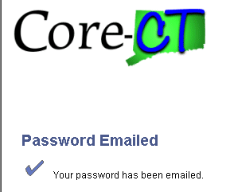
The following message displays with notification that a temporary password has been emailed to you at the email address that Core-CT has on file for you.
Check your email account for an email from corect@po.state.ct.us. This email will contain your temporary password.

Slide 18
Enter your User ID and the temporary system generated password sent in the email. Click the Sign In button.

Slide 19
For Assistance….
Call
860-465-5746
Email
payroll@easternct.edu
Visit the Website
https://www.easternct.edu/fiscal-affairs/payroll.html
Password Resets
For password resets email payroll at payroll@easternct.edu.
All requests must come from an Eastern email.

