Slide 1

EASTERN
Teacher Certification Instructions
Spring 2026

Slide 2
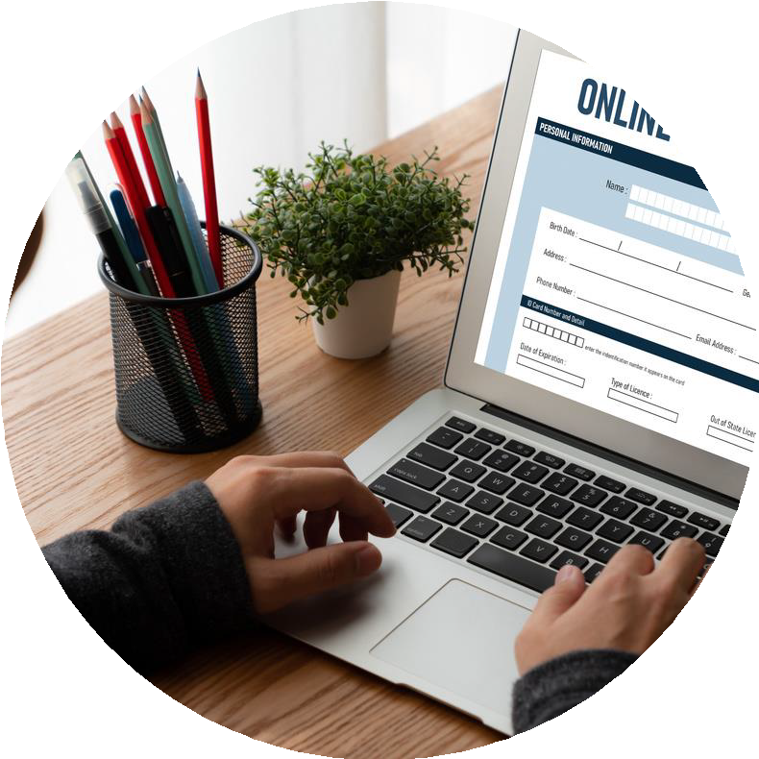


TWO APPLICATIONS:
Eastern’s Application: TK20
WATCH this instructional video for assistance
CT State Department of Education Application
WATCH this instructional video for assistance

Slide 3
FOR EASTERN’S APPLICATION:
EIN NUMBER CLOCK HOURS
PROOF OF DYSLEXIA
MODULE COMPLETION
Obtain this by visiting this website. Save your username and password. You will need it again.
Keep your EIN in a safe place.
Fill in the digital chart on TK20 or
upload a signed copy
12 hours total
MUST complete the “SLD/Dyslexia Webinar Series for Educator Preparation Programs”
And an additional 6
hours of other Dyslexia modules
HPE CANDIDATES ONLY
NEED FIRST AID CARD
Make sure it’s not
expired

Slide 4

FOR THE STATE APPLICATION:
Certification Application Video
Effective October 1, 2025, there is no longer a fee/cost
TRANSCRIPTS
for a ten-year initial educator certificate.
If someone submitted an application PRIOR TO OCTOBER 1, 2025—they no longer have to pay the additional $150 payment towards the total cost of $200 for issuance of a ten-year initial educator certificate.
Transcript Requests (Parchment) - Eastern
Click the link above for instructions on how to send them from Eastern to the State
Exception: If the educator is working in a public school, and they wish to obtain an effective date prior to October 1, 2025, then they are still required to submit the additional cost.

Slide 5

1.
REGISTER FOR YOUR EIN
Save your username and password and keep your EIN in a safe place. You will need it again when completing your Certification Application in TK20.
APPLY TO THE STATE OF CT (Dept. of Education Application)
You can start this process early in your final semester and submit, even though you’re still working on final requirements (final transcripts sent from ECSU are required for final certification through the State but are not needed in the application itself).
2.
TIMELINE
3.
EASTERN’S APPLICATION IN TK20
You can start this process now (except for the Student Teaching Clock Hours form and Cert. Application in TK20). Be sure to save your progress. DO NOT HIT SUBMIT YET (you need to complete your Student Teaching experience before submitting all requirements).
4.
REQUEST YOUR TRANSCRIPT FOR THE STATE
It cannot be sent to the State until after you graduate and your degree has posted, but you can request it to be sent to the State now, so the registrar is informed.

Slide 6

5. AFTER COMPLETING STUDENT TEACHING EXPERIENCE
Return to your TK20 application and complete your ST Clock Hours Form and the Certification Application in TK20.
Double check that you have completed everything in both applications and that you have passed all required course work and then hit SUBMIT. Once you have done so, please email: digbyma@easternct.edu.
Please keep a copy of all documents you upload into TK20!
If you do not complete the TK20 application process for certification, Eastern cannot recommend you to the State for certification
TIMELINE CT.

Slide 7
THE FINAL PROCESS
Once you complete your student teaching, graduate, and have submitted both applications (TK20 and the state) and have passed all required coursework, please email digbyma@easternct.edu and then you can look for two things:
^{01.} Eastern will fill out your recommendation to the state IF you have met all the requirements (including all necessary testing, etc.)
Eastern sends your recommendation to the state and will send you an email letting you know we did so. At the state, it goes to a special email “bank” where it will be checked in the order it was received. If we have sent you an email confirmation, the State has it.

Slide 8
THE FINAL PROCESS
The state will inform you of any other information you may
need to turn into them, such as test scores, transcripts, etc. Please do so.
Again, sometimes you may be told that they have not received your recommendation from Eastern. If you have our email confirmation, they do have it. They have not processed it from the email “bank”.
That being said - if it’s been at least four to six weeks since graduation and everything else has been turned in, feel free to inquire with digbyma@easternct.edu for assistance.
02.

Slide 9
FAQ’S
1.
How long does it take to get my certification?
2.
Can I apply for jobs even if the state hasn’t processed my certification?
3.
I want to make sure I’m not missing anything. Can you walk me through this?
Once final grades are submitted and TK20 and state applications are completed, including your Eastern recommendation, typically, it may take 4-6 weeks for your certification to process.
Yes! If everything has been submitted and
Absolutely. Make an appointment with Marissa
you’re just waiting...
Digby
please apply! Let them (digbyma@easternct.edu) nd
know that you’re just waiting on the State to process everything.
we can meet and do it together.

Slide 10
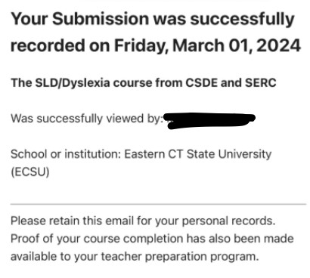
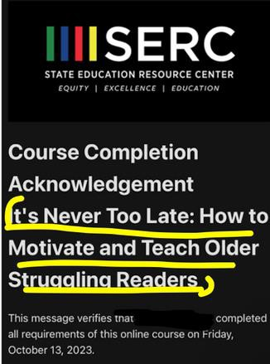
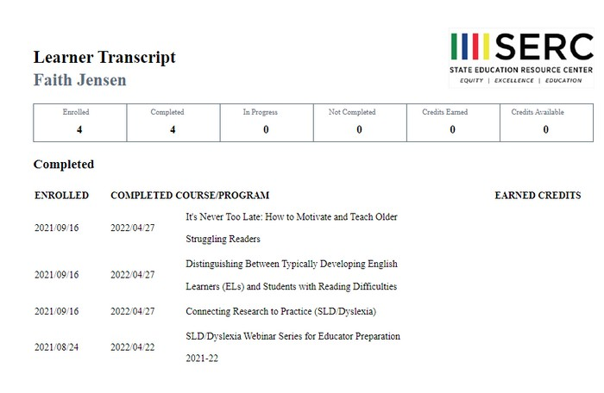


FAQ’S
4.
How do I show I took the dyslexia modules?
You will be asked to upload proof as part of the TK20 application. You need 12 hours in total, including a mandatory module. You may have images like these saved:
mandatory module
additional hours (titles may vary)
OR list that shows all
completed modules
AND

Slide 11
FAQ’S
5.
Does Eastern need my test scores?
As long as you gave permission for the testing company to share your scores, Eastern has access to your scores.
Check in with Marissa Digby (digbyma@easternct.edu) with questions.
6.
I’m not sure what I need
to finish certification.
First, review this PowerPoint, then we recommend you meet with your education advisor. You can also email Marissa Digby (digbyma@easternct.edu) to see what information is missing for your certification.

Slide 12
FAQ’s
Who should I contact if I am having problems with the TK20 website/platform?
Please email tk20@easternct.edu with any questions or problems you have regarding the TK20 website/platform.
7.

Slide 13
Transition from TK20 to SL&L
Starting this upcoming Fall 2026 semester, we will be transitioning from using TK20 to a new platform called Student Learning and Licensure (SL&L).
Any documentation uploaded to your Student Teaching Portfolio over the Summer or not uploaded before the Fall semester, please also email to digbyma@easternct.edu and/or collwellr@easternct.edu as TK20 accounts will no longer be active by the start of the Fall semester.
Please reach out to digbyma@easternct.edu or collwellr@easternct.edu with any questions you may have!

Slide 14
Eastern’s Certification Webpage
CT Department of Education Webpage
REFERENCES

Slide 15

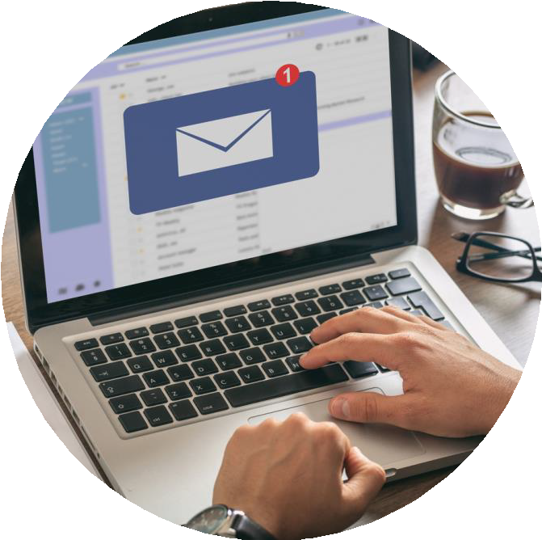


Marissa Digby- Certification Auditor digbyma@easternct.edu For certification process questions.
Dr. Ryan Colwell- Certification Officer, Assistant Dean colwellr@easternct.edu
For course requirement questions.
QUESTIONS?

