Slide 1
CARE Talk: Teacher Preparation at Eastern
Dr. Mark Fabrizi
Chair, Education Department
Professor, Secondary Education in English
ECSU, Fall 2023

Slide 2
Agenda
Welcome to the Annual C.A.R.E. Talk
Eastern Aspiring Educators Club and Kappa Delta Pi
Teacher Preparation at Eastern
Dr. Fabrizi
Admissions requirements
Certification programs
Pathways
Questions

Slide 3
Eastern aspiring eDUCATors Club
WEDNESDAYS
@ 3 PM COM 108 (tentative!)
Advisor: Dr. Susannah Richards (richardss@easternct.edu)

Slide 4
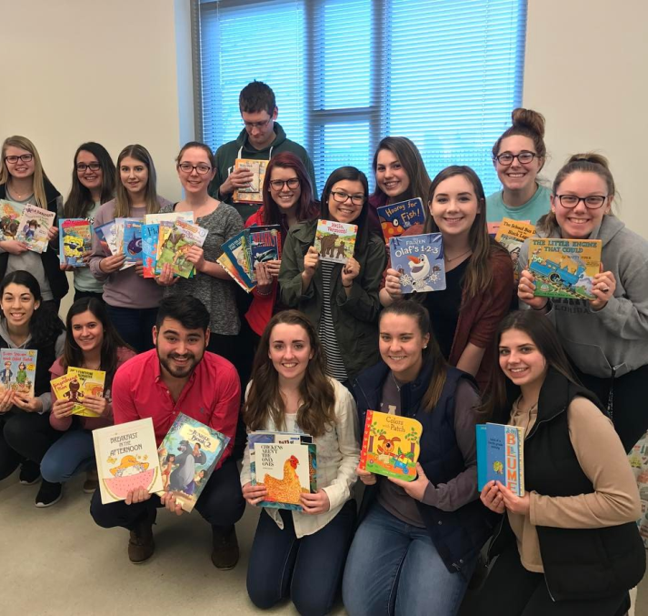
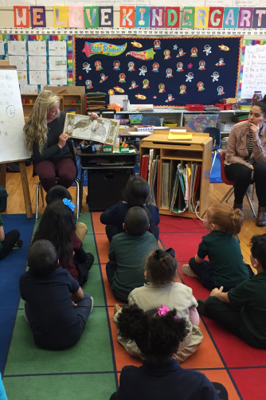
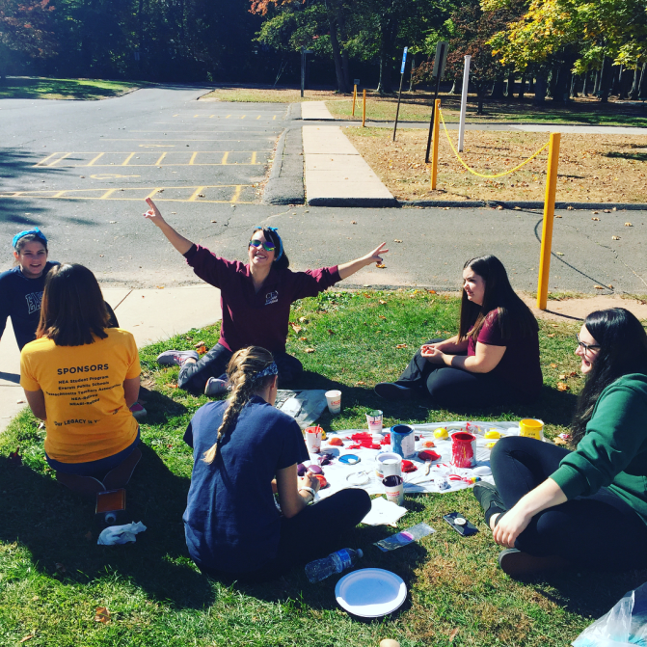
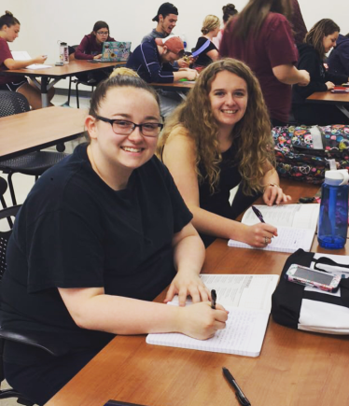
What does the club do?
Eastern Aspiring Educators
Professional Development
Attend Conference and Workshops
Volunteer
GET YOUR HOURS FOR ED PROGRAM
Community Service
Project Beautification
Socials and Networking
Have fun & meet other ed majors
Connecticut Education Association-Student Program (CEA-SP)
Connect with Aspiring Educators on state and national level
Liability Insurance & Discounts
Email for more info:
AspiringEducators@my.easternct.edu

Slide 5
Kappa Delta pi (KDP)
International Honor Society in Education

Slide 6
KDP: International Honor Society in Education
Member Benefits:
Requirements:
Wear honor cords at graduation
Member-only discounts (hotels, insurance, classroom supplies, books, etc.)
Scholarships
Classroom teacher grants
Local and national leadership opportunities
Service opportunities
Professional development
Accepted into either the undergraduate or graduate Education program at Eastern
Register & pay society & chapter dues
Attend induction
Attend two additional education events
Email: KDP@my.easternct.edu
Instagram and Twitter: @kdp_ecsu
Advisor: Dr. Moorehead

Slide 7
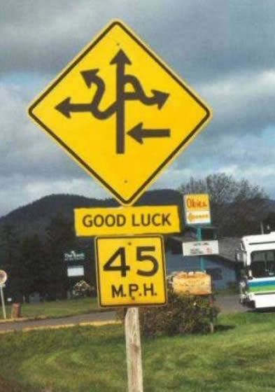
Certification Programs
Early Childhood Education (ECE)
Elementary Education (ELE)
Secondary Education (SEC)
Health/Physical Education (KPE)
Graduate and Undergraduate
Early Start Option (ESO)

Slide 8
Paths to certification
 | Undergraduate | Early Start Option (graduate) | Graduate
Early Childhood Education (PreK-3) | YES | YES | YES
Elementary Education (1-6) | YES | YES | YES
Secondary Education (7-12) ENG, MAT, BIO, EES, HSS | YES | YES | YES
Physical Education (PreK-12) | YES
All paths lead toward certification
Choose the right path for you!

Slide 9
Admission Requirements

Slide 10
Admission Requirements
Complete free application on tk20 (UG only!)
Deadline: February 15
Submit transcripts
Unofficial from Eastern
Official from all other institutions
Submit three recommendations
Forms, not letters, available on the CARE web page
http://www.easternct.edu/education/advisement
Liberal Arts professor, major professor, educator
Minimum GPA 2.70

Slide 11
Admission Requirements (KPE)
Complete free application on tk20 (UG only!)
Deadline: October 1, February 15
Post-Bacc & Transfer Students Only (January 1, August 15)
Submit transcripts
Unofficial from Eastern
Official from all other institutions
Submit three recommendations
Forms, not letters, available on the CARE web page
http://www.easternct.edu/education/advisement
Liberal Arts professor, major professor, educator, coach
Minimum GPA 2.70 min.

Slide 12
Admission Requirements
Submit standardized test scores
Take Praxis I Core (Reading, Writing, Mathematics)
Minimum scores: Read 156; Write 162; Math 150
Take SAT
Minimum scores*: 540 Reading/Writing; 530 Math
Take ACT
Minimum scores*: 21 Reading and 20 English; 20 Math
We DO NOT make admissions decisions
based upon the quality of your scores!
*Scores pertain to tests taken after March 1, 2016

Slide 13
Admission Requirements (UG only)
Submit Service Clock Hours form*
Proof of 20 hours working with children in a teaching capacity
Similar age as your intended certification area
Can be done through Center for Community Engagement (CCE) on campus
Examples: Coach, camp counselor, tutor, before/after school assistant, teacher’s aide, substitute teacher, etc.
Form must be signed by your supervisor
Upload form to your tk20 CARE application

Slide 14
Admission Requirements
Pre-admission coursework (UG only!)
Early Childhood Education (ECE)
ECE 215
PSY 206
- Elementary (ELE) and Secondary (SEC)
EDU 200
EDU 357 or EDU 210
Physical Education (HPE)
HPE 230
HPE 240
Interview (all applicants)
Conducted by Education Dept. faculty
Scheduled after application deadline

Slide 15
Certification Programs

Slide 16
Early Childhood Education
Early childhood education
PreK- Grade 3
Certifications:
Special ed. and general ed. PreK-K and general ed., grades 1-3
Need a content area major: Anything except PE
Unique Opportunities
Research at Center for Early Childhood Education
Clinical experience at CFDRC preschool

Slide 17
Elementary Education
General certification for grades 1-6
You are responsible for delivering all content including:
Math, History/Social Studies, English, and Science
Certification requirements:
Four field experiences (two clinical, pre-student teaching, and student teaching)
In addition to coursework, you must successfully pass the following standardized tests:
Connecticut Foundations of Reading
Praxis II
Need a content area major
Anything except PE, PSY, and SOC

Slide 18
Secondary Education
Secondary certification
Focus on a single content area
Certification in grades 7-12
BUT, you can teach in sixth grade (or even fifth grade) in a middle school
Certification areas:
Math, History/Social Studies, English, Biology, Earth Science
Must pass the Praxis II test in your content area
Cross-endorsement (ELE or ECE candidates)
See content area advisor:
Dr. Fabrizi (ENG), Dr. Rodriguez (SCI), Dr. Stoloff (HSS), Dr. Swaminathan (MAT)

Slide 19
Physical Education
P-12 Physical Education Certification
Focus on a single content area (i.e., KPE)
Certification in grades P-12
Can also teach Adapted Physical Education in CT
Must pass the Praxis II test in your content area
Cross-endorsement (Health Education)
Built into Course Sequencing Advisement Sheet:
30 credits (19 are typically in PE major already)
Additional courses: HPE 245, 340, 310, 312, 448 (other electives available)
Advisor for PE/Health Certification: Dr. Robert

Slide 20
Pathways to Certification

Slide 21
Undergraduate Program
Complete the program in four semesters
KPE program is completed in eight semesters
Cohort begins in Fall Semester
Cohort size: 30 candidates max
What happens if I don’t get in?
Don’t worry—all is not lost!

Slide 22
Early Start Option Graduate Program
Early Start Option
Apply to CARE and Graduate Division in one application!
Deadlines: The first of the month, Sept.-Jan.
Priority deadline: October 1
Senior year (90-105 credits)
Begin taking classes in Spring Semester
Finish undergrad program and graduate in May
Continue program at grad level
Summer classes → Fall → Spring (student teaching)
Graduate with M.S. Ed. and certification in May

Slide 23
Early Start Option
Benefits
Save money on grad school by starting as an undergrad
Takes one additional calendar year to complete Master’s
Command higher salary in most districts
This will not be held against you as an applicant, according to every administrator I have interviewed
Enroll in education classes only
Easier to complete undergraduate degree on time
Drawbacks
More expensive (however: see bullet #3 above)
Delays your start into teaching

Slide 24
Graduate Program
Traditional graduate program
Apply to CARE and Graduate Division in one application!
Applications accepted on the first of every month
Begin taking classes in any semester
Program takes three full semesters, plus summer
Graduate with M.S. Ed.
More expensive than Early Start
All classes taken at graduate level
Flexible starting semesters

Slide 25
Questions
Consider your options
You may not have to decide right now
What questions do you have?
Whom to contact:
Early Childhood Education
Dr. Theresa Bouley (bouleyt@easternct.edu)
Elementary Education
Dr. Susannah Richards (richardss@easternct.edu)
Secondary Education
Dr. Mark Fabrizi (fabrizim@easternct.edu)
Physical Education
Dr. Darren Robert (robertd@easternct.edu)

