Slide 1
Vaccine Supply Chain Systems: An Analysis Using Operations Management Perspective
Nancy Gonzalez, Nicole Thomassen, Aidan Dunn, and Merita Cecunjanin
Advisor Professor:
Dr. Fatma Pakdil

Slide 2
Presentation Plan
Research Motivation
General Information
Systematic Literature Review Method Used
Distribution of Data Collected

Slide 3
Research Motivation
Vaccination supply chain systems and all components
Consideration of unique COVID-19 Supply Chain
Interest in:
*Analyzing vaccine supply chain system
Developing optimization model

Slide 4
General Information
Eastern Connecticut State University
Fall 2021
BUS 480 Independent Study: Supply Chain Systematic Literature Review
Four students and Professor
Weekly Friday meetings (8/27/21-12/3/21)

Slide 5
Systematic Literature Review Method
Planning
Develop research questions
Develop a review protocol
Conducting the review
Identification of research
Study selection
Reporting the review
Specify the dissemination strategy
Identify the need for a systematic review
Evaluate the review protocol
Study quality assessment
Data extraction
Data synthesis
Format the main systematic review report
Evaluate systematic review report

Slide 6
Planning
Research Questions
Review Protocol: Search Strategies
Inclusion and Exclusion Criteria

Slide 7
Research Questions
What has been found about vaccine supply chains in previous studies reported in literature?
What was found in previous vaccination supply chains regarding components such as...
Operations Management
Management Science
Public Health related methods
Tools and techniques
Previous approaches
Notes:
The need: The first COVID-19 vaccination rollout was very complicated since we experienced several delays, bottlenecks, obstacles, and challenges.

Slide 8
Review Protocol: Search Strategies
Eastern Library Databases:
ABI/INFORM Collection (ProQuest, Research IT CT)
Business Source Premier (EBSCO)
MEDLINE (EBSCO)
ScienceDirect (ELSEVIER)
Web of Science

Slide 9
Inclusion and Exclusion Criteria
Total # of articles after incorporating inclusion/exclusion criteria: 144
Total # of articles after reviewing based on selection criteria: 93
Criteria | Items
Inclusion criteria | Full-text articles published in peer-reviewed scholarly journals, theses, book chapters, and books Published in English between 2000 and 2020 The publications found in selected digital databases in primary search The articles including identified key words*
Exclusion criteria | Articles published in non-scholarly journals Not full-text articles Materials published in other languages Duplicated studies Conference proceedings

Slide 10
Conducting and Reporting the Review
Conducting Review
Primary Search: 144 Articles
After Article Analysis: 118 Articles
Reporting Review
Report Table Collection
Bar Graphs

Slide 11
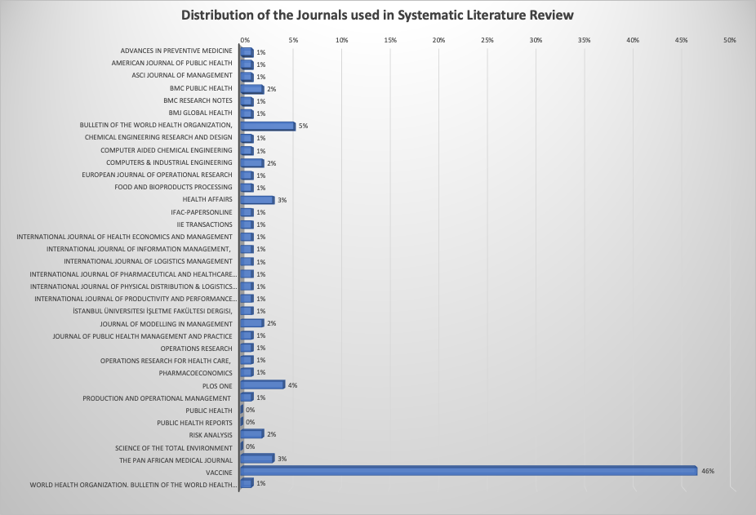

Slide 12
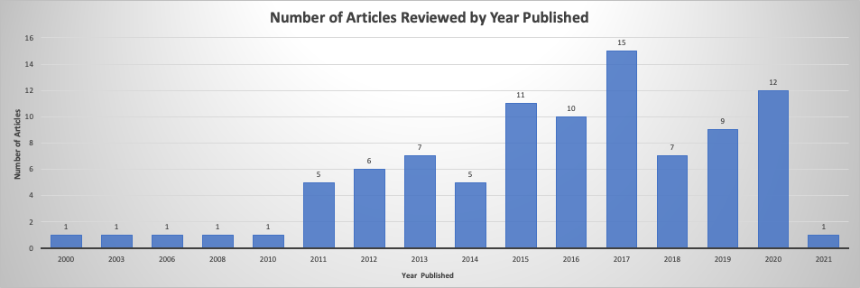

Slide 13
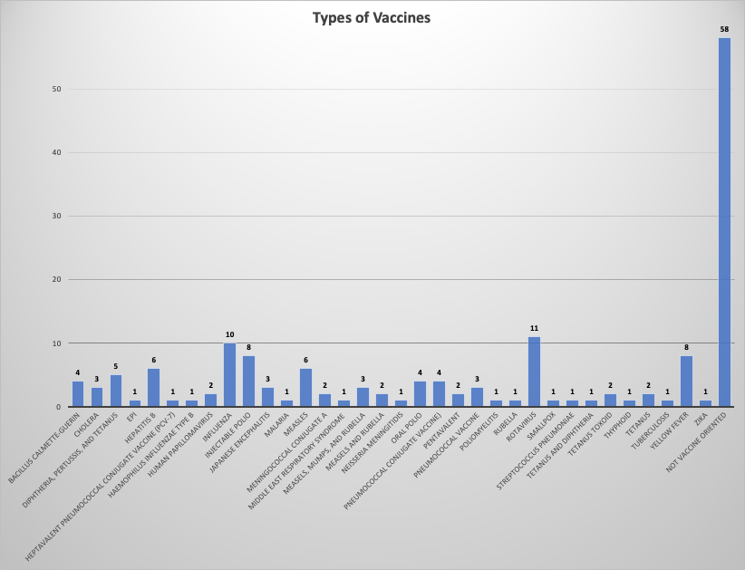

Slide 14
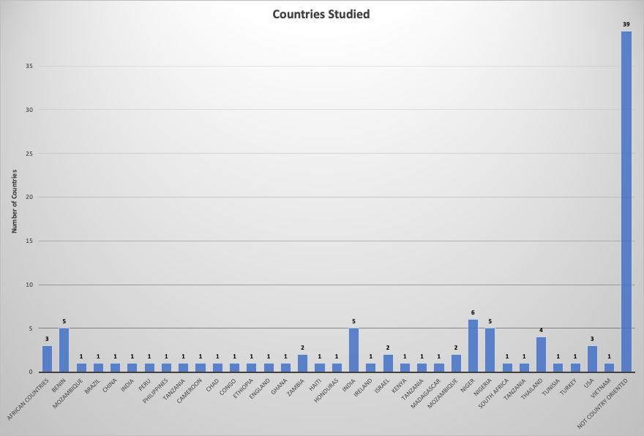

Slide 16
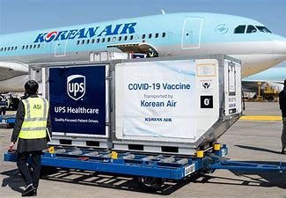
Conclusion
Literature and practice have heavily focused on improving vaccine supply chains starting from 2010s.
The majority of the related papers have been published in Vaccine.
Most common methods used in literature:
Simulation method most common
HERMES (Highly Extensible Resource for Modeling Supply-Chains)
Transportation component
Storage capacity
Economic analysis and scenario analysis
Analysis on cost of immunization programs
Simplifying vaccine supply chains

Slide 17
Conclusion
Although several publications have focused on implementing operations management-, simulation- and operations research-oriented quantitative methods, there is still a significant need in using such advanced quantitative methods in vaccine supply chain design processes.
The size and degree of complexity of vaccine supply chain systems require using such methods for optimizing such complex and big systems from operations and public health perspectives.

Slide 18
Questions

